Slide 1
Modeling the Draining of a bottle
Sometimes Predicting the Future is Easier than Deciphering the Past and Other Aspects of …
John McClain, Lecturer, University of New Hampshire
JMM 2020: AMS Special Session 7A: Wall to Wall Modeling Activities in DE Courses
Saturday January 18th, 2020

Slide 2
Outline
Overview of Activity
Major Pedagogical Elements of the Activity
Pre-Activity Coursework and Class Characteristics
Walk through data collection and data-driven model
Work through differential equations model
Post-Activity Coursework
Questions

Slide 3
What’s in the activity?
Goal: to model the height of a liquid column in a bottle as it drains through a small hole.
Steps:
Collect Data from Video
Create a regression model
Derive a differential equations model from physical law/reasoning
Solve differential equation
Create and solve initial value problem (IVP)
Model verification
Adapted from 1-15-T-Torricelli, SIMIODE modeling scenario by Dr. Brian Winkel, Professor Emeritus, USMA, Director SIMIODE.

Slide 4
Pedagogical Elements
This activity requires students to:
Compare and contrast data-driven, regression model with physically-reasoned, differential equations model.
Review/practice using the limit definition of derivative.
Derive a differential equation from physical reasoning.
Give physical meaning to an IVP.
Practice solving a separable equation/IVP (with atypical notation)
Give physical meaning to existence and uniqueness of solutions.
Give physical meaning to differentiable, piecewise-defined functions.

Slide 5
Class Characteristics
~150-200 students
Overwhelmingly sophomores
Prerequisites: Calculus I and II
Linear Algebra is part of the course
Whole-class lectures 3x per week
~20 student recitations 2x per week
Modeling Scenarios started in lecture, finished in recitation
4-5 Modeling Scenarios per semester

Slide 6
Pre-Activity Coursework
Characterizing and solving separable equations.
$$y^{′}=f\left(x\right)g\left(y\right)$$
Defining initial conditions and initial value problems.
Perhaps, reviewing the limit definition of derivative and $Δ$ notation.
$$y^{′}=\lim_{Δx→0}\frac{Δy}{Δx}$$

Slide 7
Data-Driven, Regression Model
Data collection video
From SIMIODE:
Brian Winkel (2015), "1-015-S-Torricelli," https://www.simiode.org/resources/488.
Go to Modeling Scenario worksheet.

Slide 11
Physical, Differential Equations Model
Torricelli’s Law
Equating the change in fluid volume at the top to the change of fluid volume at the hole.
Work on Section 2, #9 and #10.

Slide 12
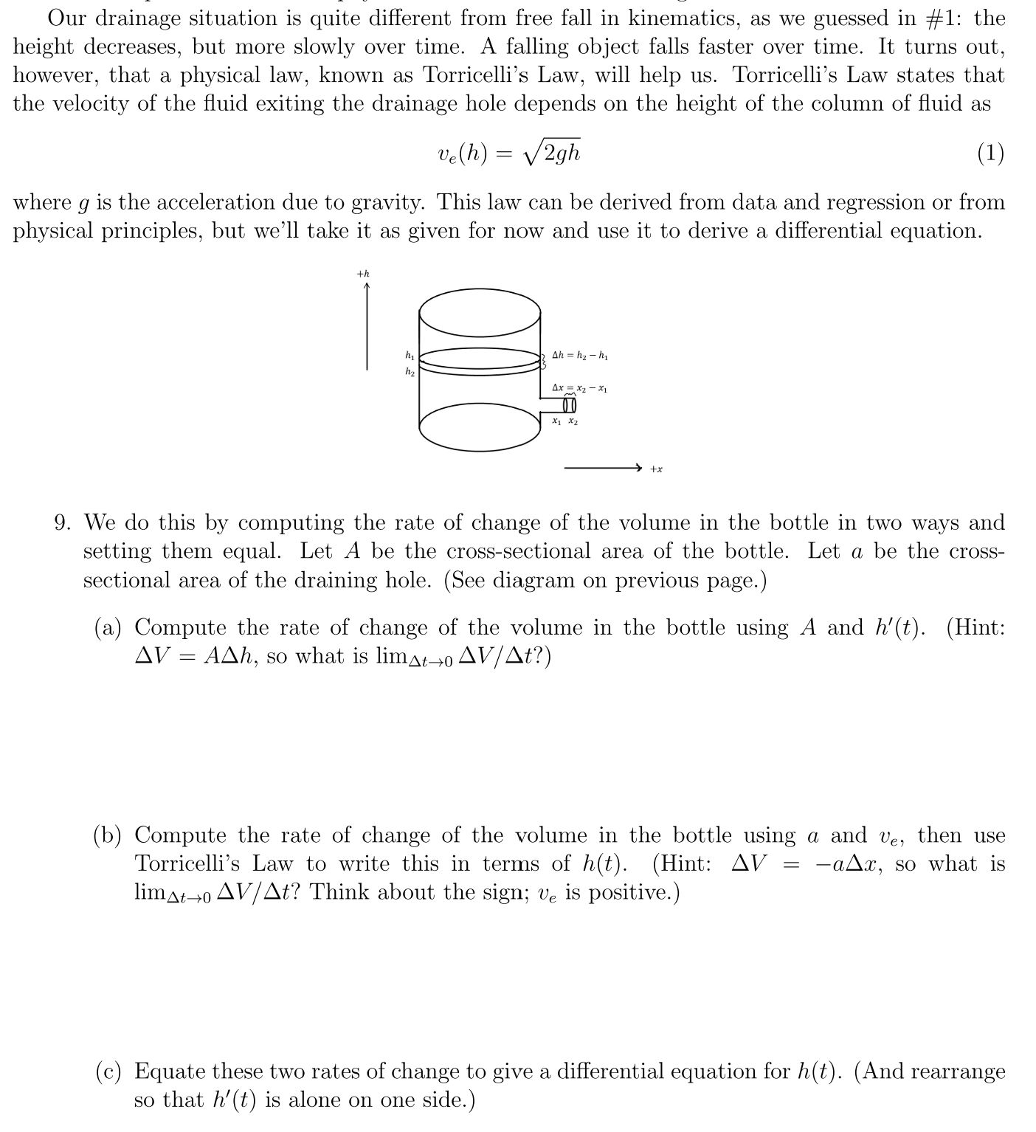

Slide 13
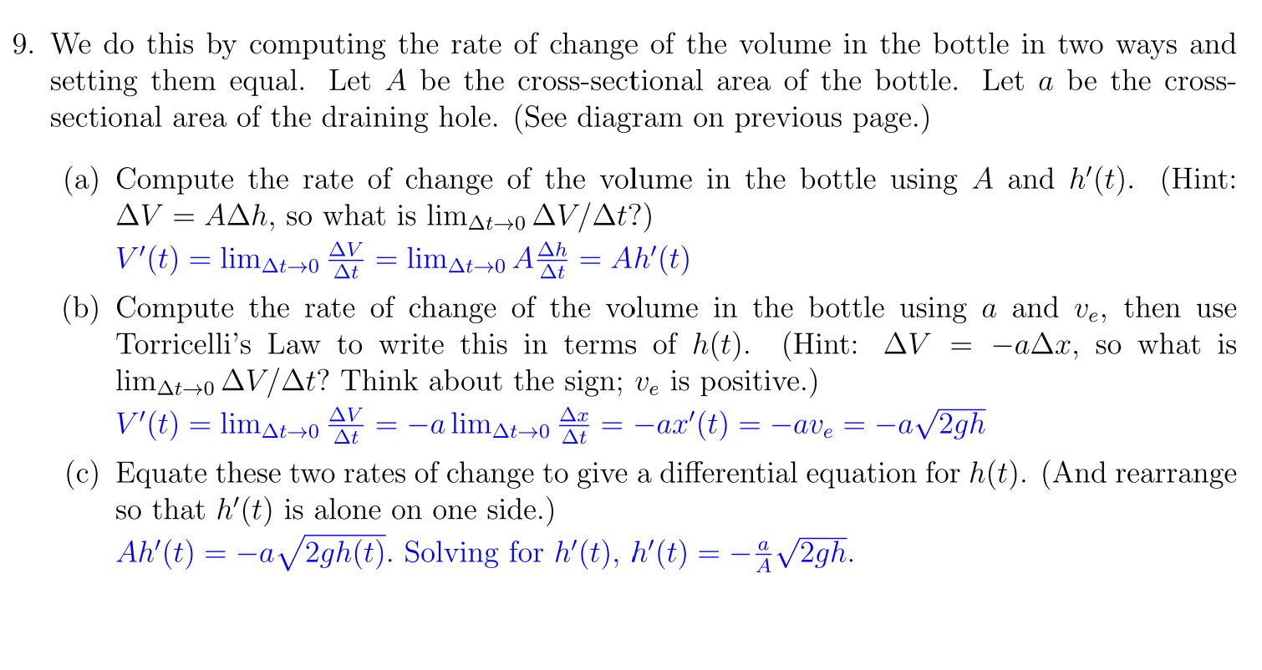

Slide 17
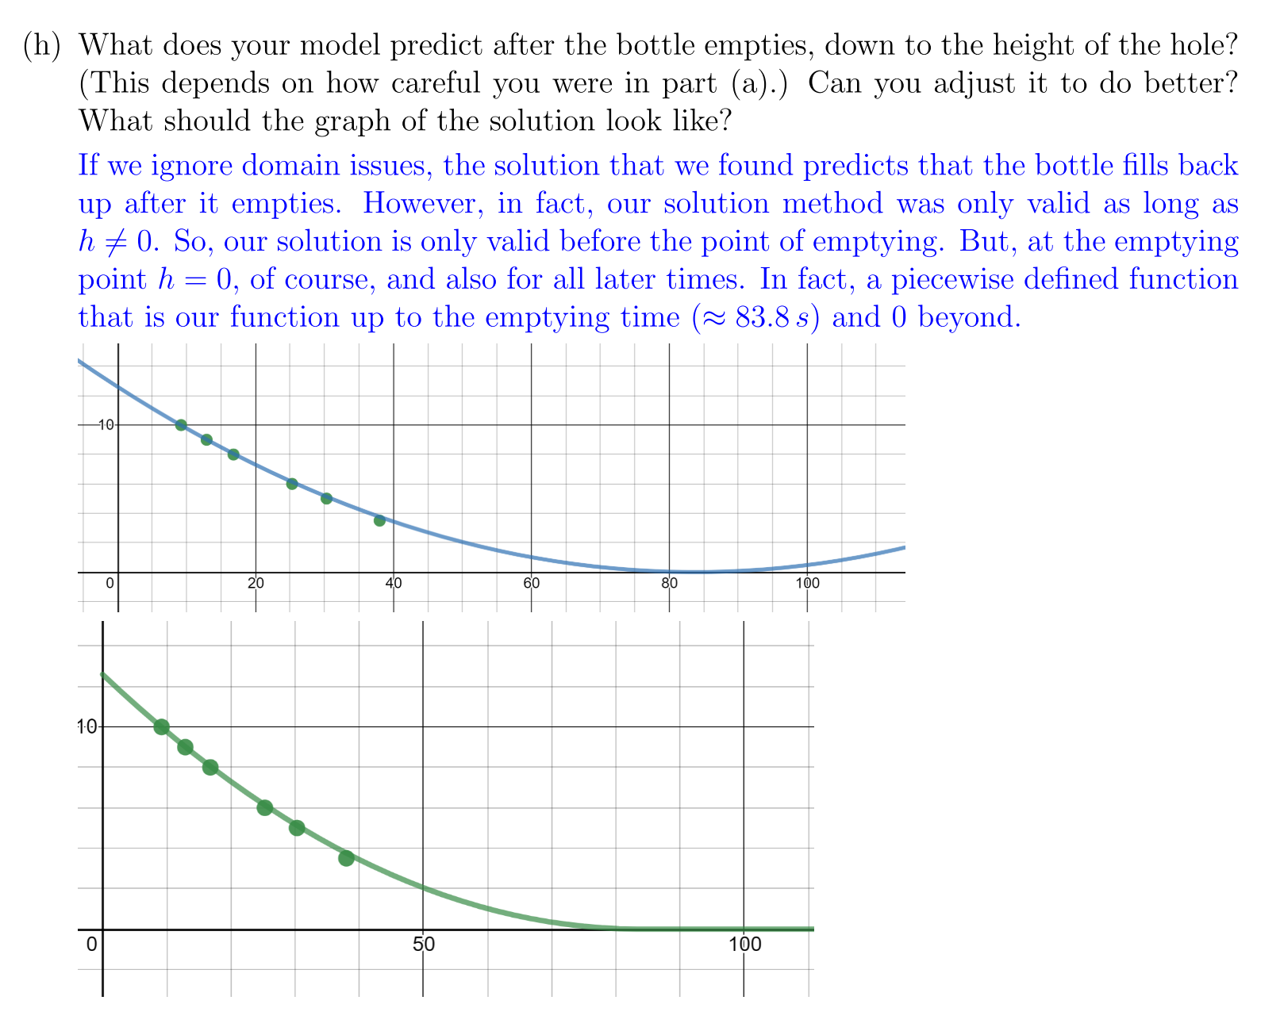

Slide 18
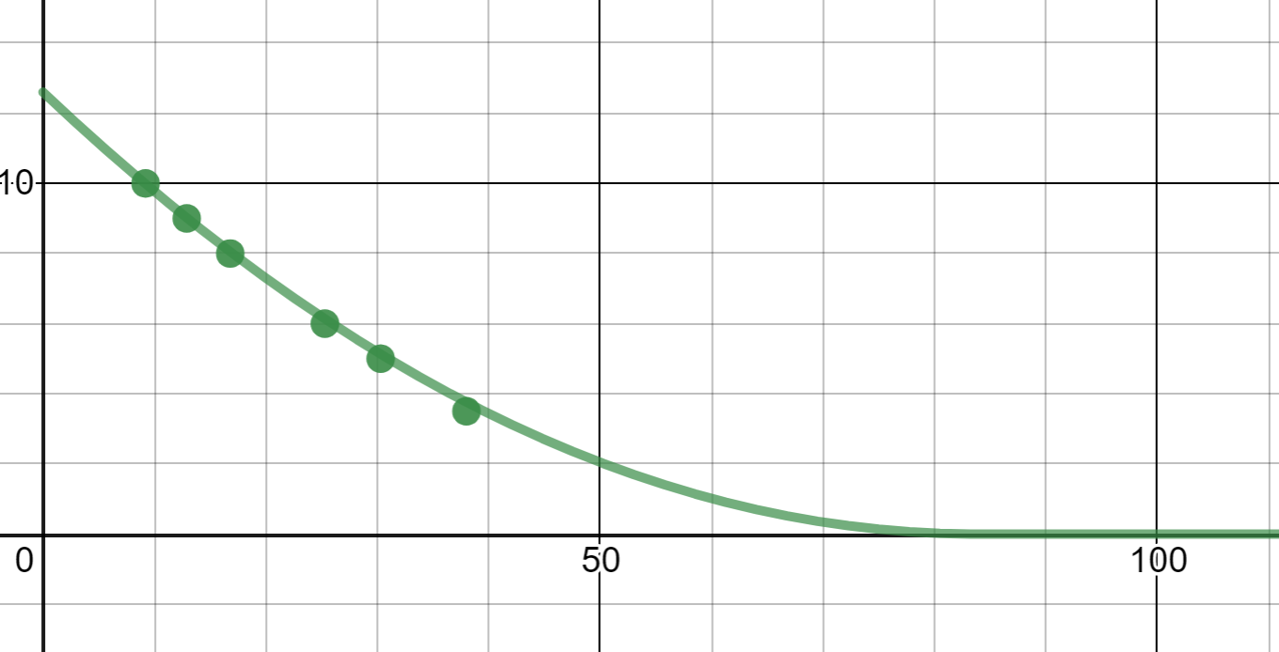
Post-Activity Coursework
More model verification (Desmos.com)

Slide 19
Post-Activity Coursework
More model verification
Desmos plot
Existence and Uniqueness (Predicting the future vs deciphering the past)
If initial condition is $h\left(t_{0}\right)=h_{0}>0$, then a unique solution is guaranteed by Picard’s Theorem.
If we know the height at some time when bottle is not empty, our model explains past and predicts future.
If initial condition is $h\left(t_{0}\right)=0$, Picard’s Theorem (and most others) does not apply.
If we know a time when the bottle is empty, we can predict the future, but have no knowledge of the past.

Slide 20
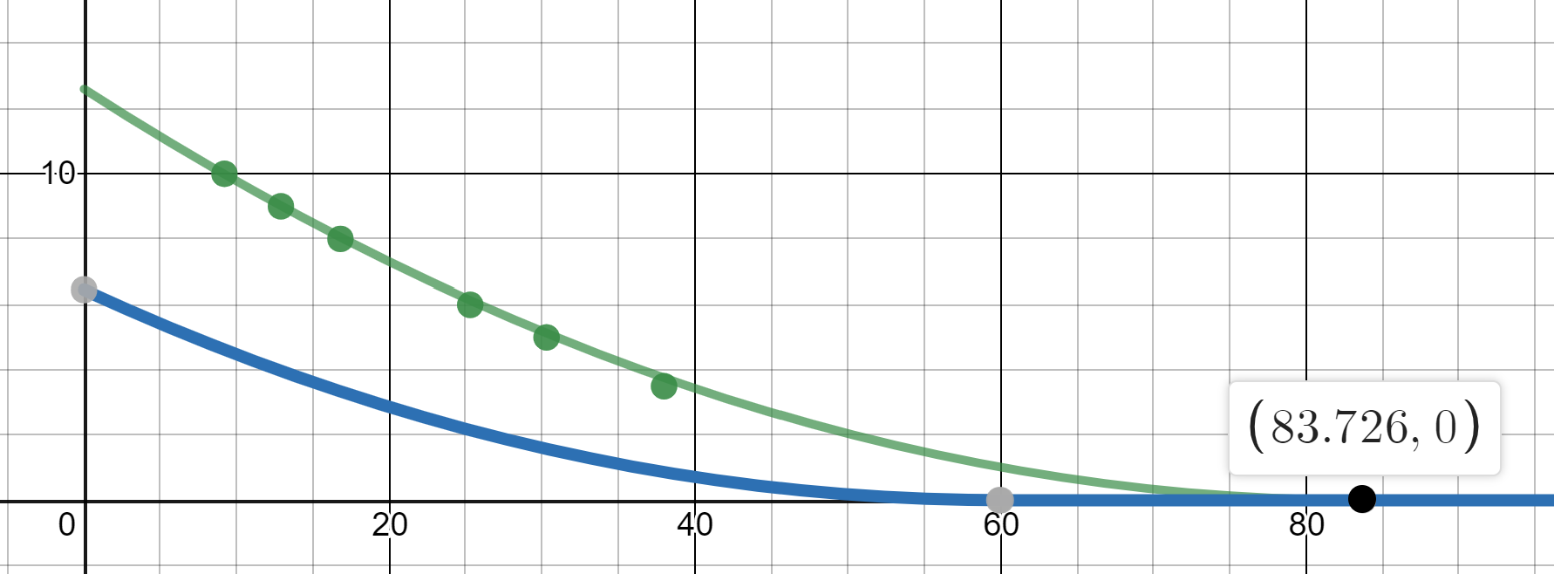
Non-uniqueness: If the bottle is empty at $≈84 s$, it could have emptied any time before.

Slide 21
Post-activity Coursework
Homework problem asking students to show that the piecewise solution is differentiable and is a solution.
One-sided derivatives or limits involved.
Very difficult for students.
Many do not grasp the significance.

Slide 22
Post-activity Coursework
Final Exam Extra Credit Problem
Completely unprompted; draining a bottle not included on exam topic list
“Give an example of a physical system that can be modeled by an initial value problem which has multiple solutions. (In other words, while solutions exist, there is not a unique solution.) Describe the physical system, the initial condition, and at least two solutions.”
~13 of 184 described draining a bottle.

Slide 23
Thanks!
Questions?

