Slide 1
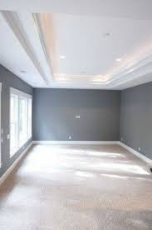
MAA Minicourse #10
Wall to Wall Modeling Scenarios for Differential Equations
Part A - Thursday 16 January 2020, 9:00 AM - 11:00 AM
Room 704, Meeting Room Level, Colorado Convention Center
10:00 AM Brian Winkel, SIMIODE, Cornwall NY USA
Oil Slick Spread & Chem Data Collection – Both Done Poorly
In which we model the spread of an oil slick with poorly collected data
and similarly we attempt to model a chemical reaction with poorly collected data.

Slide 2
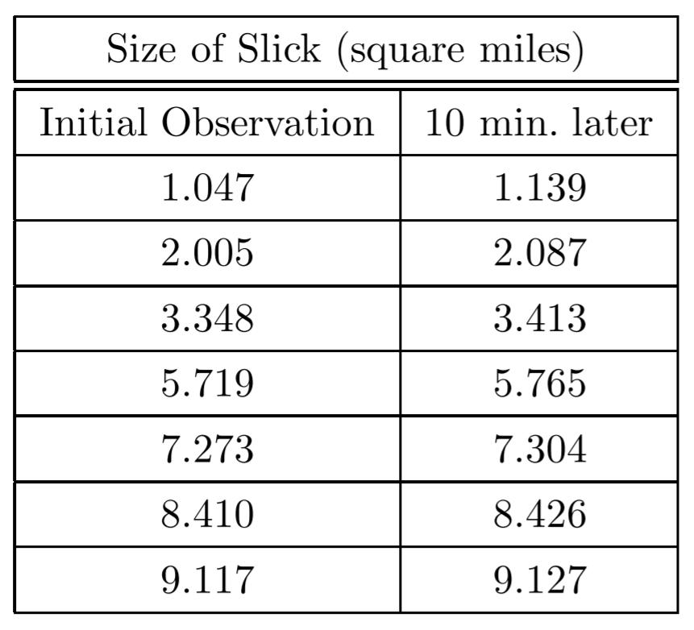
Model spread of an
oil slick with poorly
collected data.
Brian Winkel (2015), "1-005-S-OilSlick," https://www.simiode.org/resources/196 .
Brian Winkel (2015), "1-005-T-OilSlick," https://www.simiode.org/resources/184 .
Taylor, P. D. 1975. Calculus with Modelling for Science Majors. Applied Mathematics Notes. 1(2): 64-74.

Slide 3
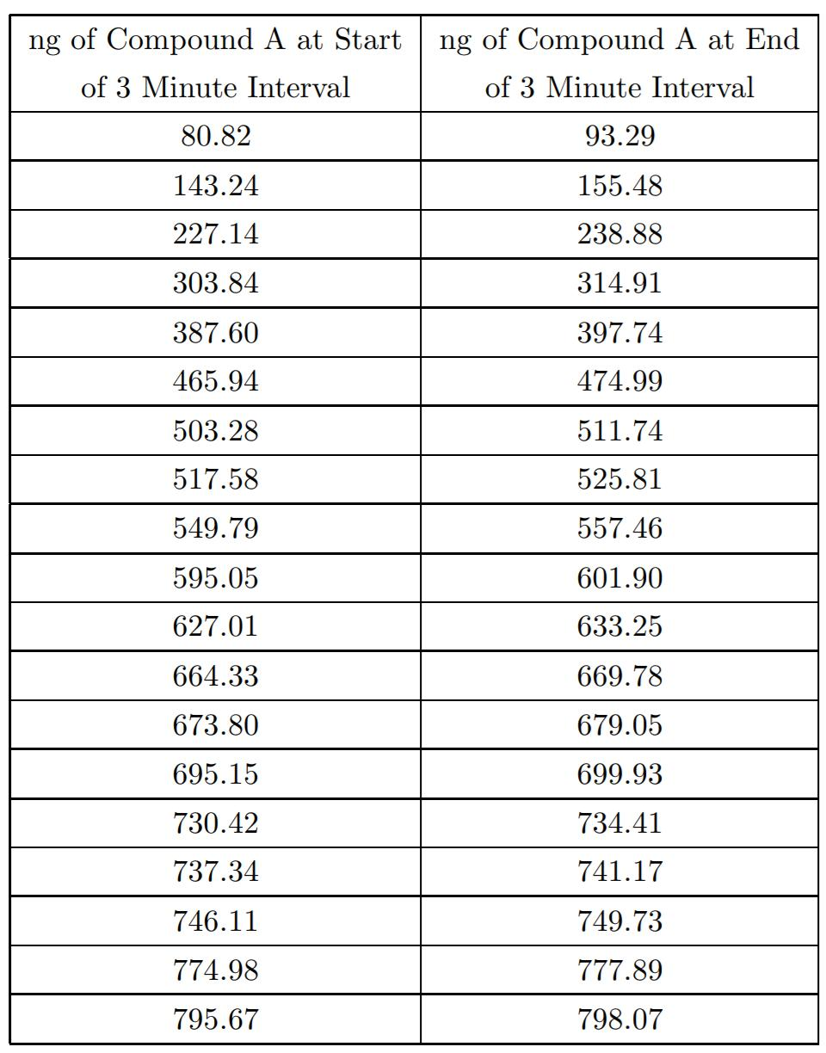
Brian Winkel (2015), "1-005B-S-ChemDataCollection," https://www.simiode.org/resources/223 .
Brian Winkel (2015), "1-005B-T-ChemDataCollection," https://www.simiode.org/resources/215 .

Slide 4
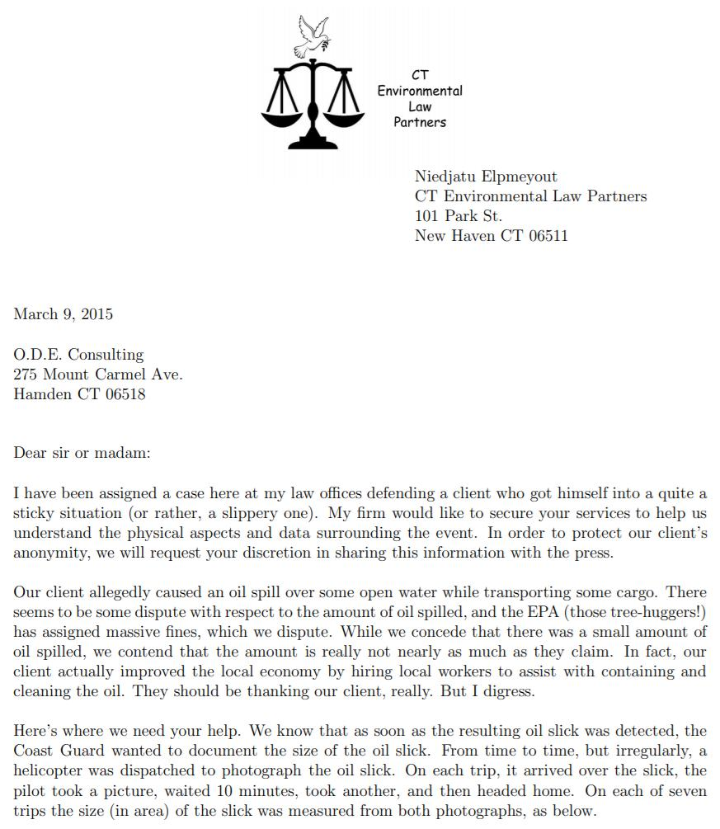
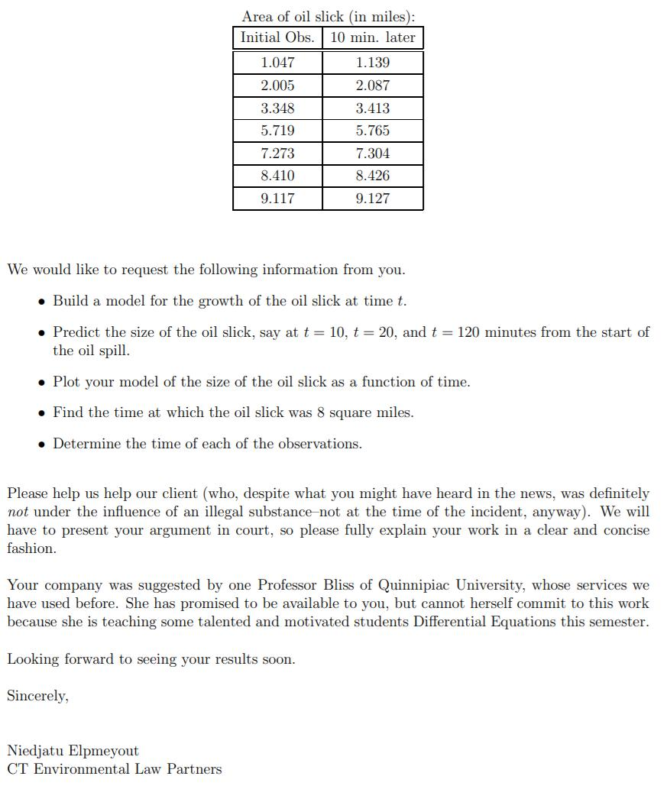
Karen Bliss, Virginia Military Institute, Lexington VA USA used class as consultant approach.

Slide 5
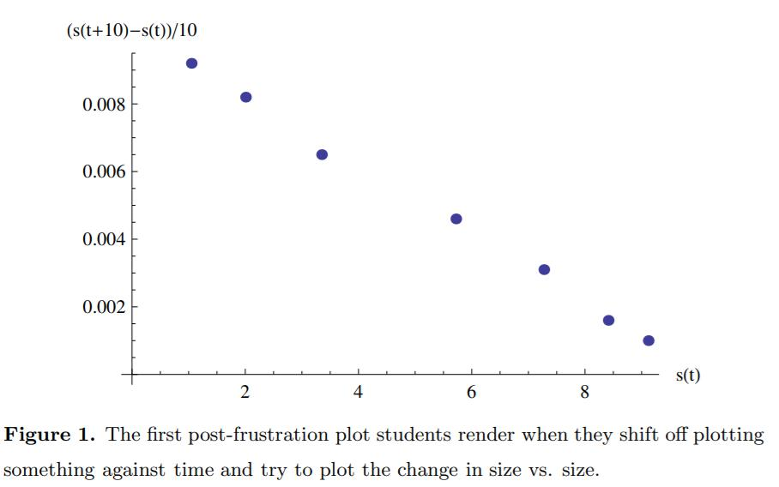
An AHA! moment occurs . . . . .

Slide 6
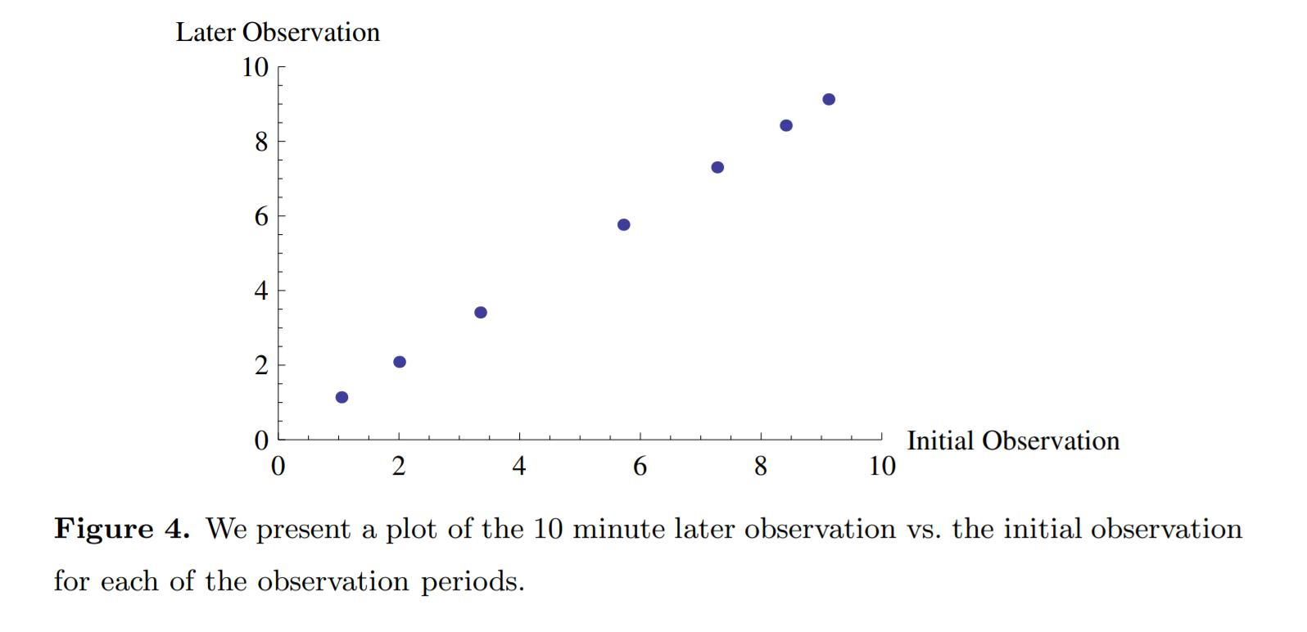
Another route to an AHA! moment . . . . .

Slide 7
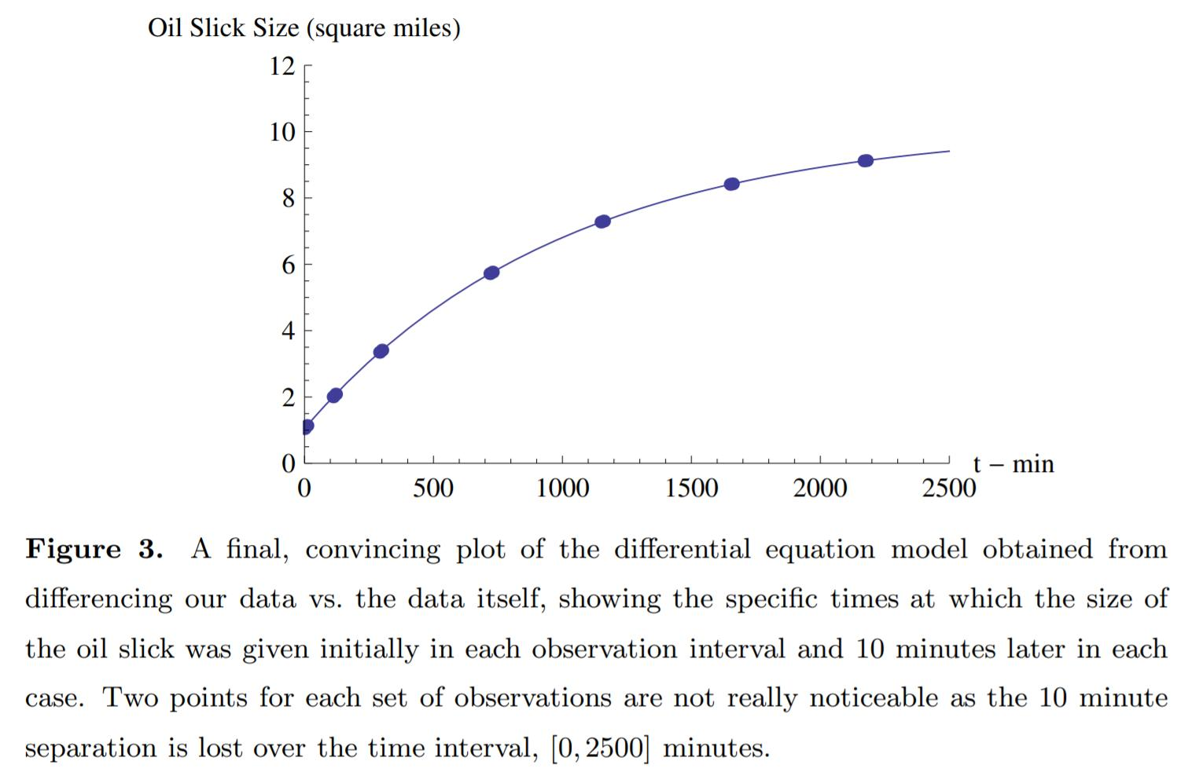
After solving differential equation (or difference equation) model. . .

Slide 8
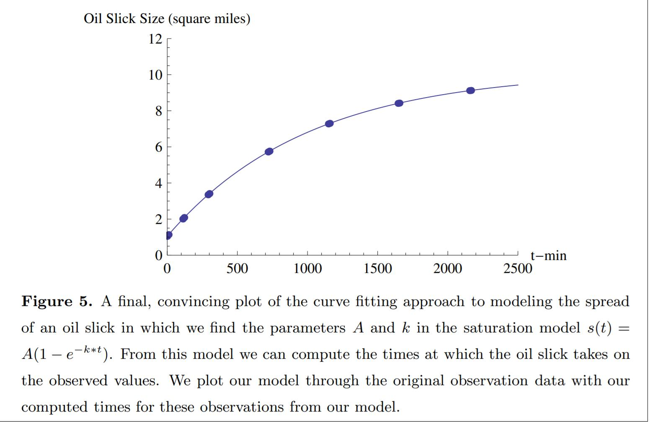
Another route to an AHA! moment . . . . .

Slide 9
And now for something completely different . . . . . .
you have to read the Teacher Version
of the Modeling Scenario!!!!!
Brian Winkel (2015), "1-005-T-OilSlick," https://www.simiode.org/resources/184 .

Slide 10
Still another idea . . . . assume a model . . .
Find the six initial times for each post initial interval
AND the parameters A and k in one fell swoop.

