Slide 1
Project NExT Session - New Experiences in Teaching
Using Mathematical Software: Effective Use of
Computer Software in Mathematics Classrooms
Personnel Computer Background – summer 1966 to present
Use of computer in pre-differential equations course work
(3) Increase computer utilization in a differential equations course with
an emphasis on parameter estimation and the full cycle of modeling
Brian Winkel, Director, SIMIODE, Cornwall NY USA
Emeritus Professor of Mathematics, United States Military Academy, West Point NY USA
Emeritus Founding Editor PRIMUS – Problems, Resources, and Issues in Mathematics Undergraduate Studies

Slide 2
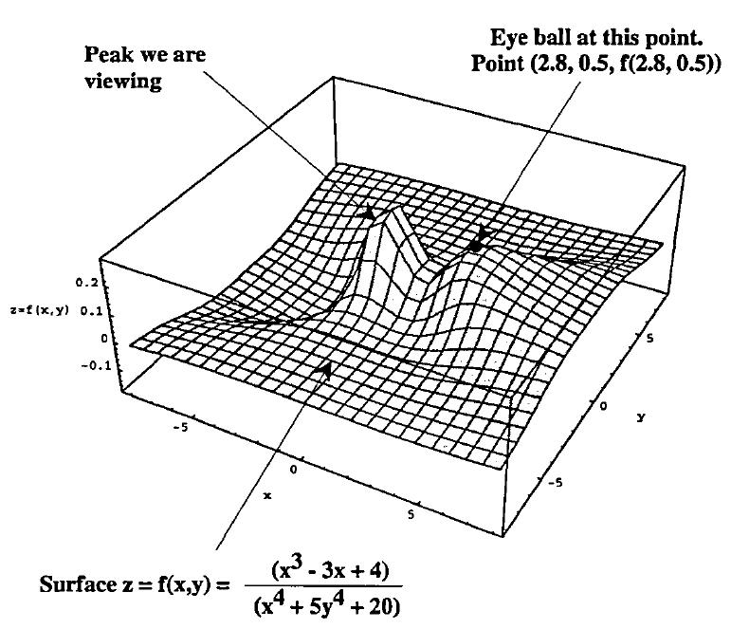
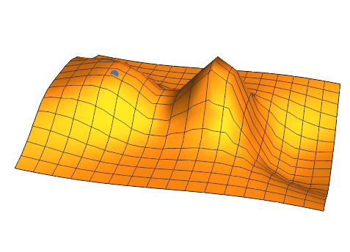
From a point on a mountain slope how much surface can you
see on a mountain across the valley from where you sit?
Reference: Winkel, B. J. 1997. In plane view: an exercise in visualization. International Journal of Mathematical
Education in Science and Technology. 28 (4): 599-607.

Slide 3
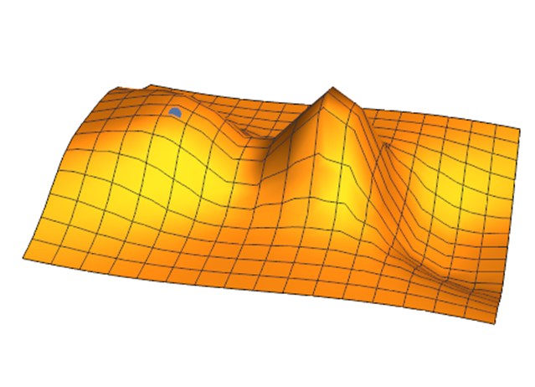
What are the mathematical notions
and strategies to enable you to address
the following questions?
How much surface can you see on a mountain across the valley from where you sit at blue dot?

Slide 4
What are the mathematical notions
and strategies to enable you to address
the following questions?
How much surface can you see on a mountain across the valley from where you sit at blue dot?
What is nearest point on a mountain across the valley from where you sit at blue dot?

Slide 5
What are the mathematical notions
and strategies to enable you to address
the following questions?
How much surface can you see on a mountain across the valley from where you sit at blue dot?
What is nearest point on a mountain across the valley from where you sit at blue dot?
What is angle of highest (lowest) elevation to a point on a mountain across the valley from where you sit at blue dot?

Slide 6
What are the mathematical notions
and strategies to enable you to address
the following questions?
How much surface can you see on a mountain across the valley from where you sit at blue dot?
What is nearest point on a mountain across the valley from where you sit at blue dot?
What is angle of highest (lowest) elevation to a point on a mountain across the valley from where you sit at blue dot?
Where should you position yourself on the mountain so that you see the most surface area on the mountain on the other side of the valley?

Slide 7
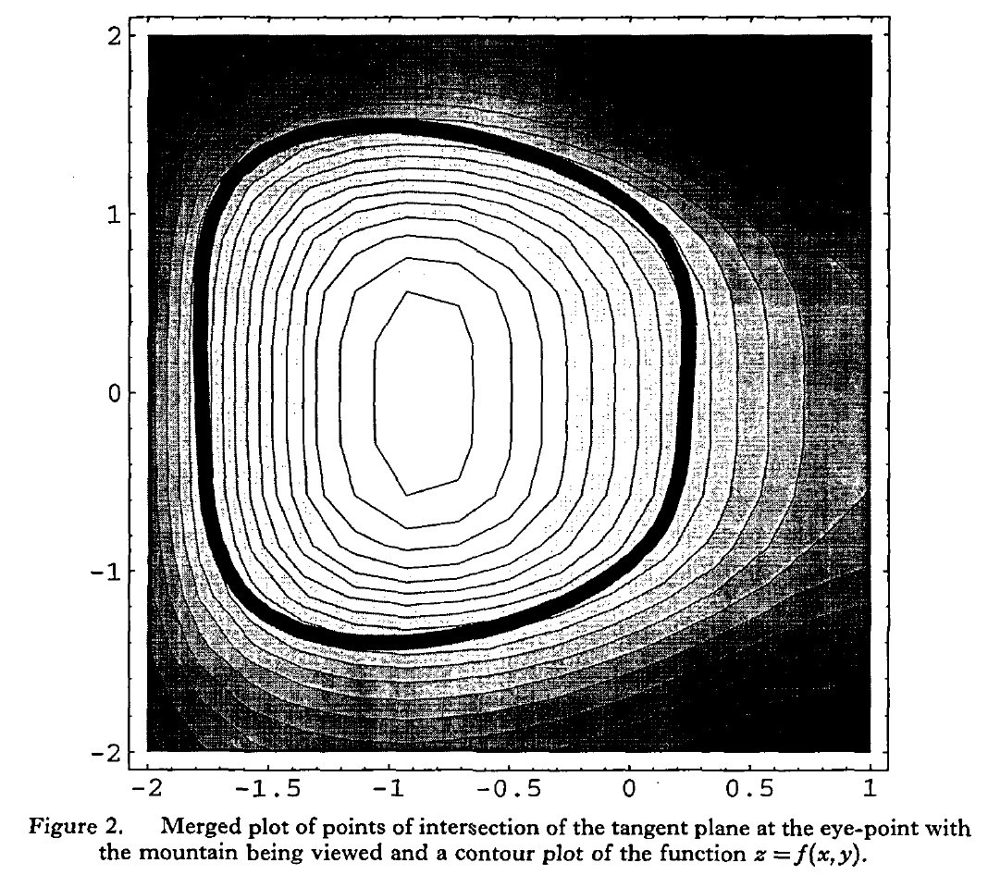
What mathematics is in this picture?

Slide 8
What mathematics is in this picture?

Slide 9
What mathematics is in this picture?
What do the arrows signify?

Slide 10
What mathematics is in this picture?
What do the arrows signify?
What other boundary do we need?
How do we get that other boundary?

Slide 11
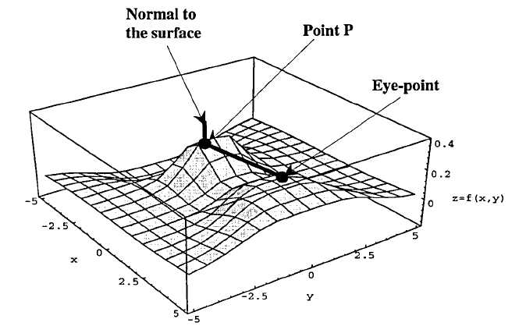
What mathematics is in this picture?
What do the arrows signify?
What other boundary do we need?
How do we get that other boundary?

Slide 12
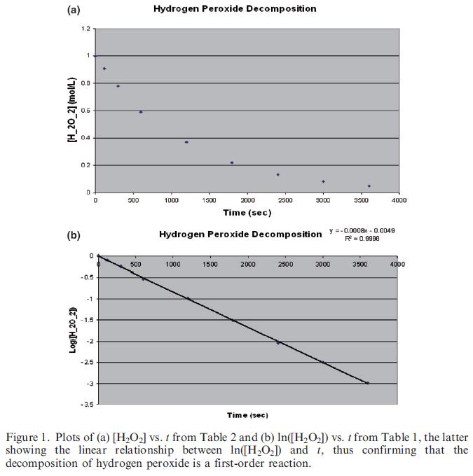
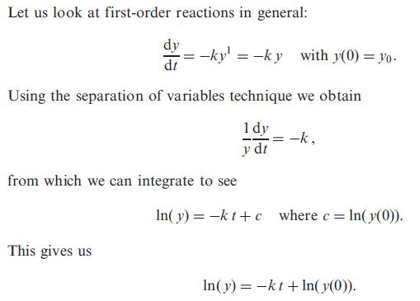
Reference: Winkel, B. J. 2011. Parameter estimates in differential equation models for chemical kinetics. International Journal of Mathematical Education in Science and Technology. 42(1): 37-51.

Slide 13
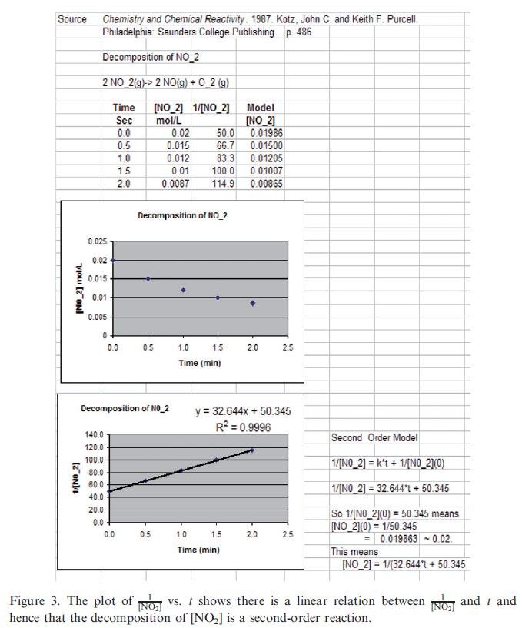
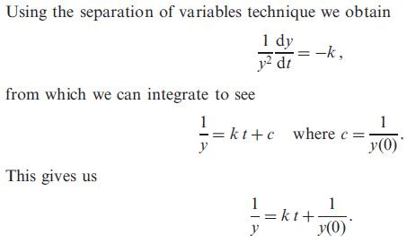

Slide 14
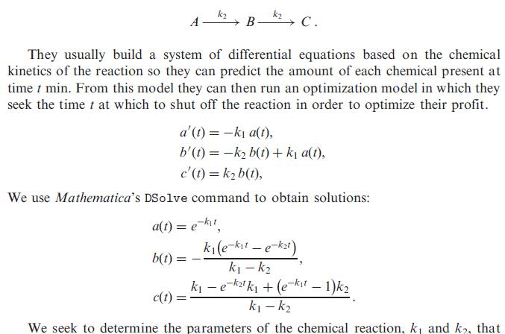
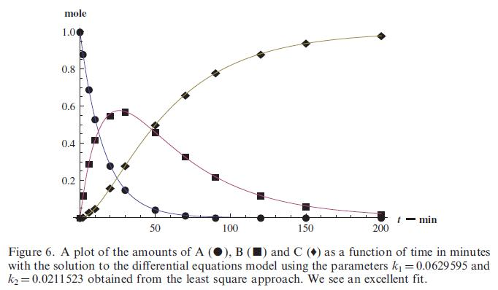

Slide 15
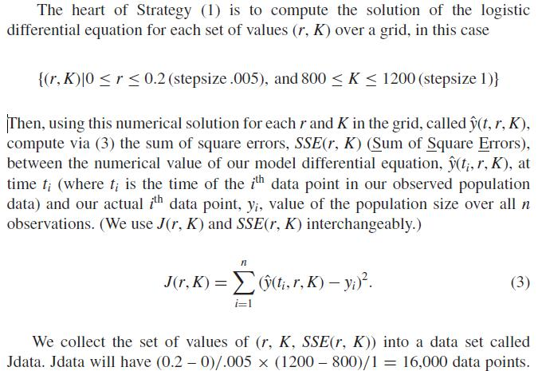
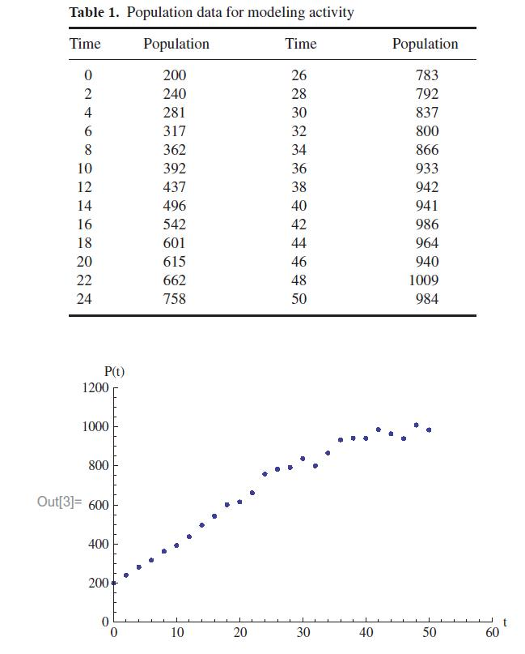
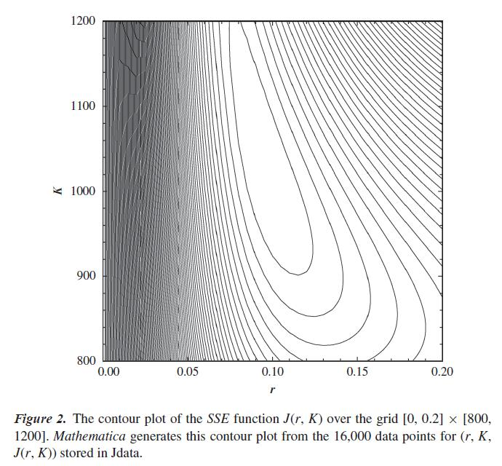
Reference: Winkel, B. J. 2011. Parameter Estimates in Differential Equation Models for Population Growth. PRIMUS. 21(2): 101-129.

Slide 16
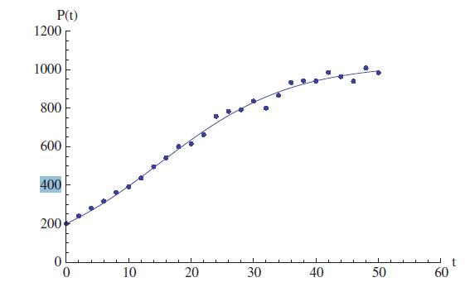
r = 0.095
K = 1029
Reference: Winkel, B. J. 2011. Parameter Estimates in Differential Equation Models for Population Growth. PRIMUS. 21(2): 101-129.

Slide 17
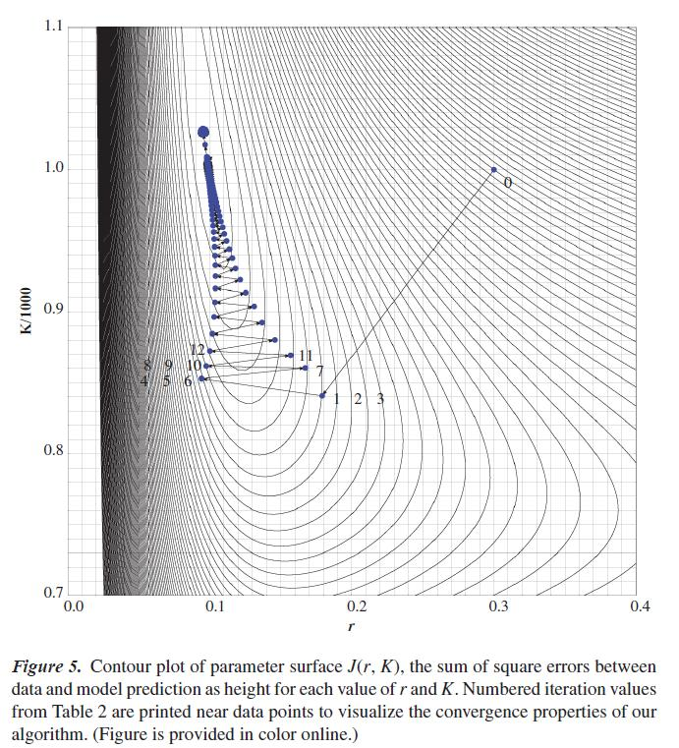
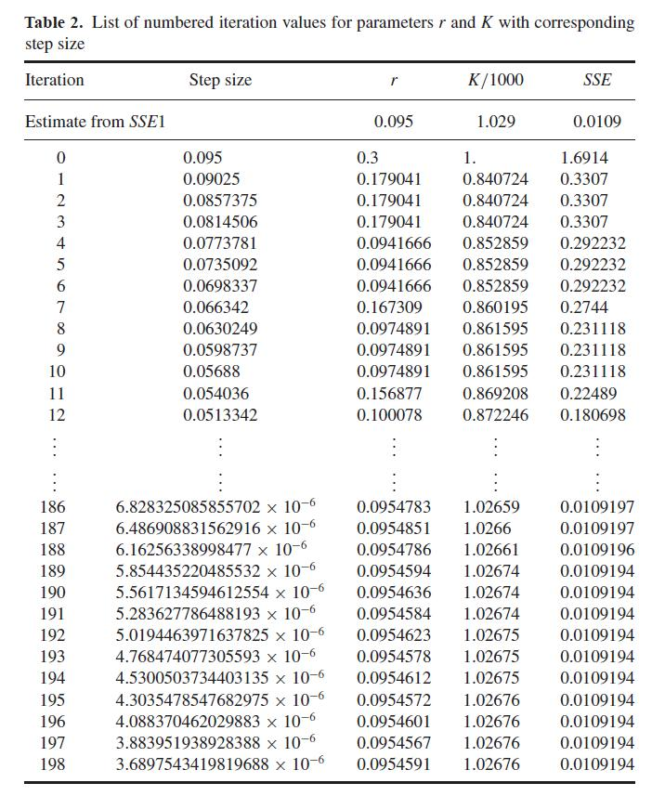
Gradient approach on parameter surface: (r, K/1000, SSE(r, K/1000)).

Slide 18
Thank you.
Time for more.
Time for discussion.
BrianWinkel@simiode.org

