Slide 1


AMS Special Session II
Using Modeling to Motivate the Study of Differential Equations
Opportunities for Community in Using Modeling to
Teach Differential Equations at SIMIODE
Brian Winkel, Director SIMIODE, Cornwall NY USA

Slide 2


The basics
ALL IS FREE IN SIMIODE!
SIMIODE is a 501(c)3 nonprofit organization.
SIMIODE began in Spring 2013.
SIMIODE is HUBZero platform.
SIMIODE is dedicated to providing resources and community.
SIMIODE supports the use of modeling in teaching differential equations.
SIMIODE is funded by the National Science Foundation.

Slide 3

HUBzero® is an open source software platform for building powerful websites
that host analytical tools, publish data, share resources, collaborate and
build communities in a single web-based ecosystem.
Originally created by researchers at Purdue University in conjunction with the
NSF-sponsored Network for Computational Nanotechnology to support nanoHUB.org,
the HUBzero platform now supports over 60+ science gateways built from the
HUBzero platform with a collective of over 2 million visitors a year.

Slide 4
Heart of SIMIODE

Slide 5
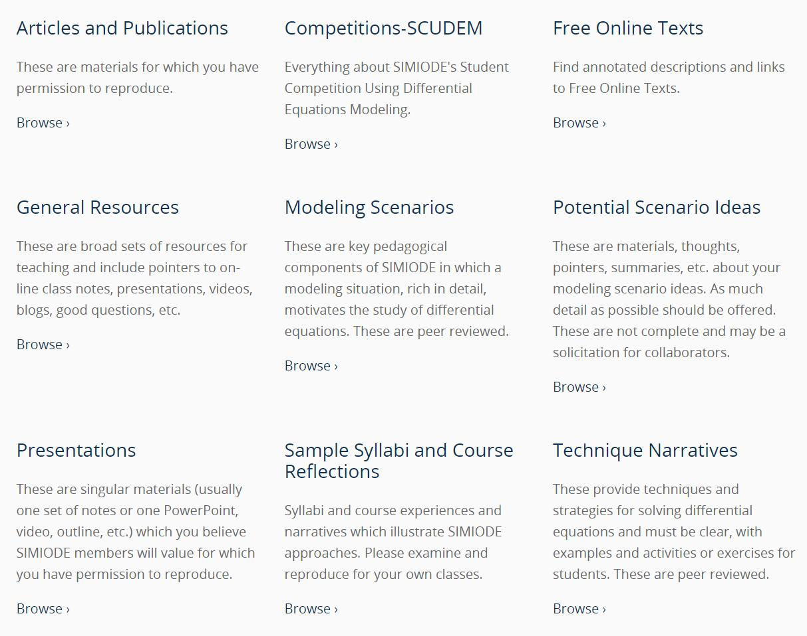

Slide 6

But let’s get personal first!

Slide 7
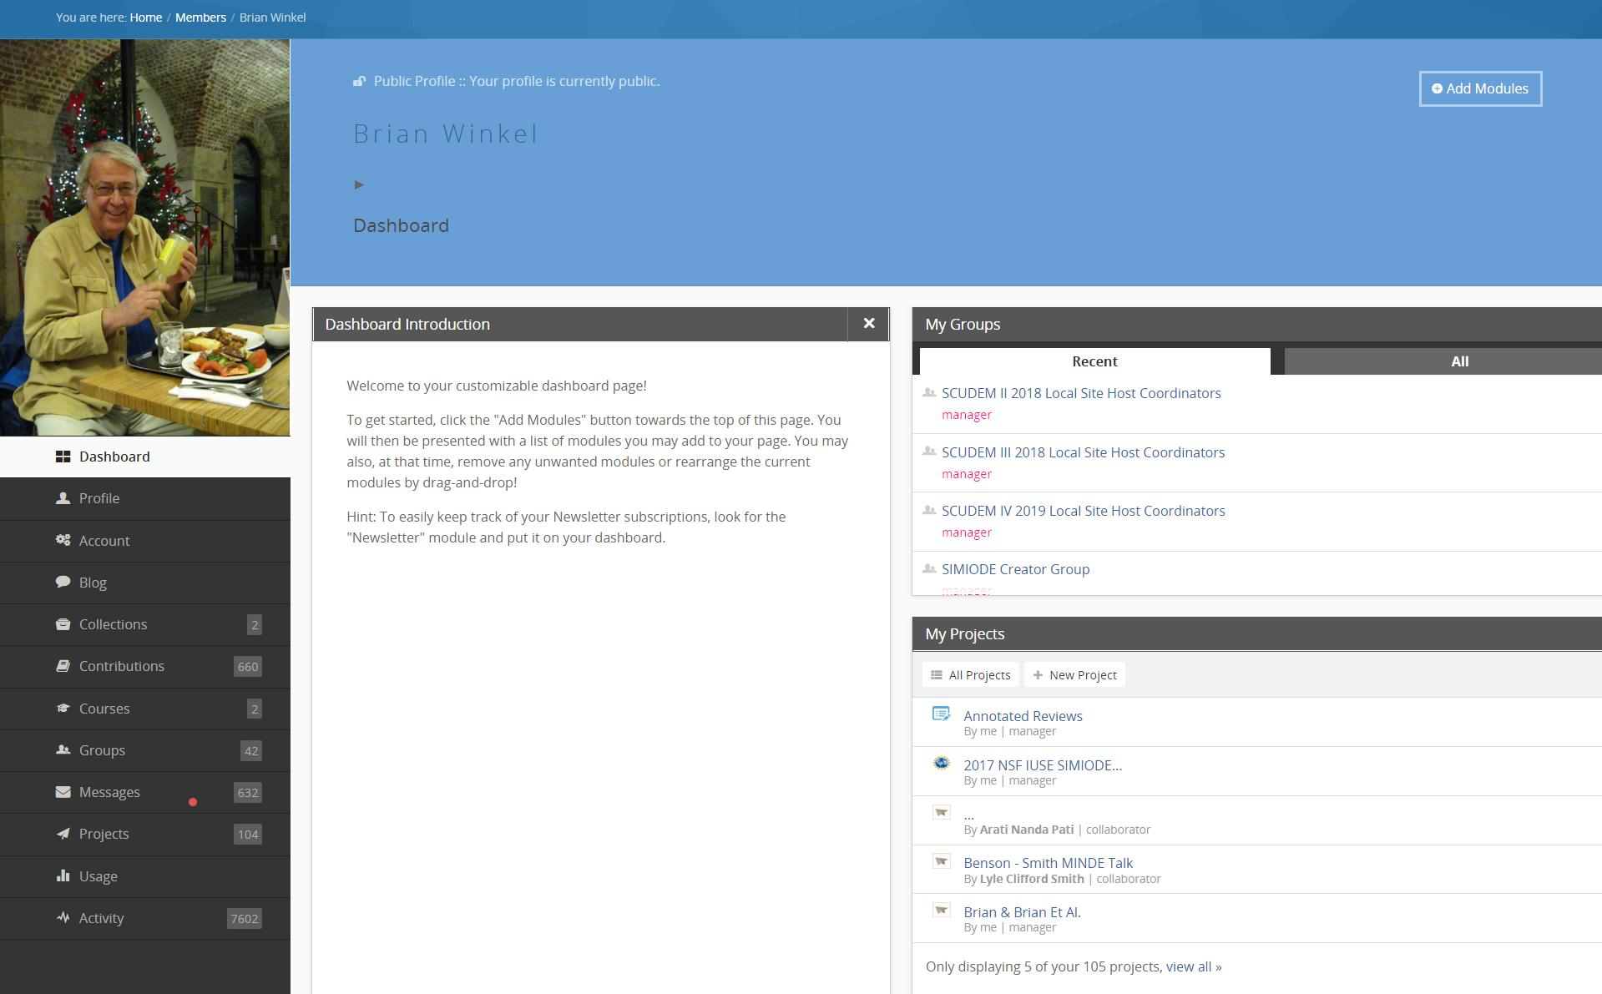
Personal Dashboard

Slide 8
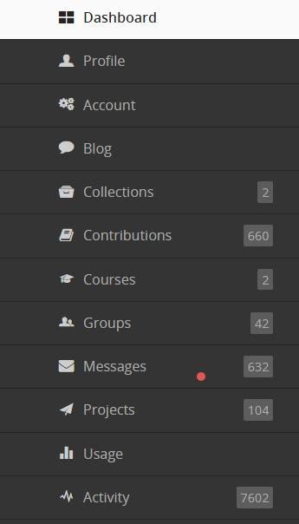
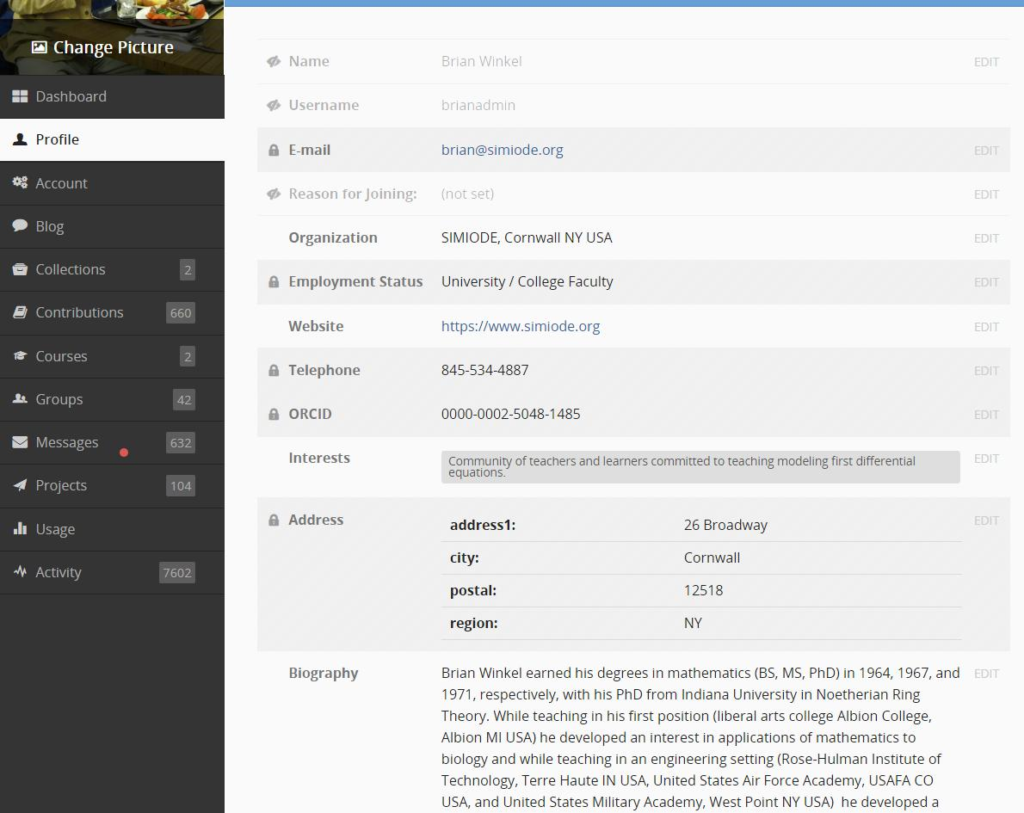

Slide 9
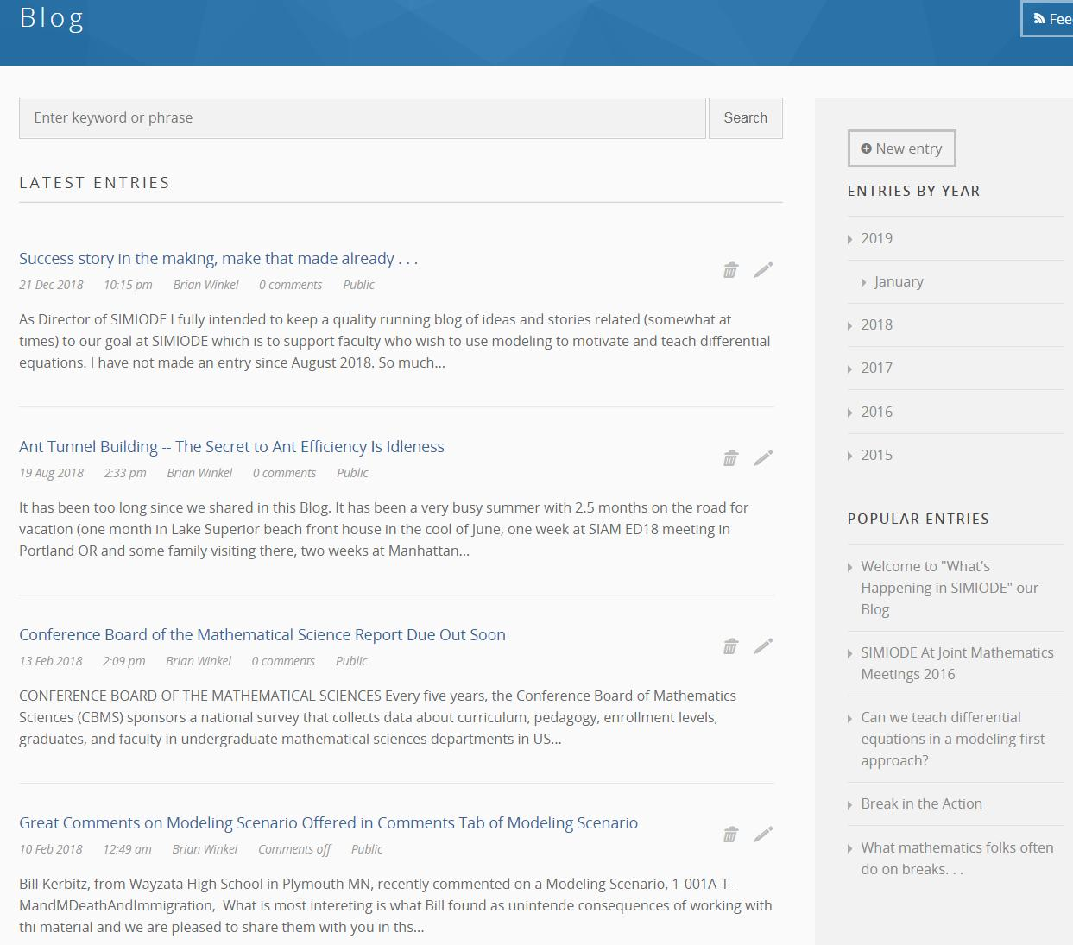

Slide 10
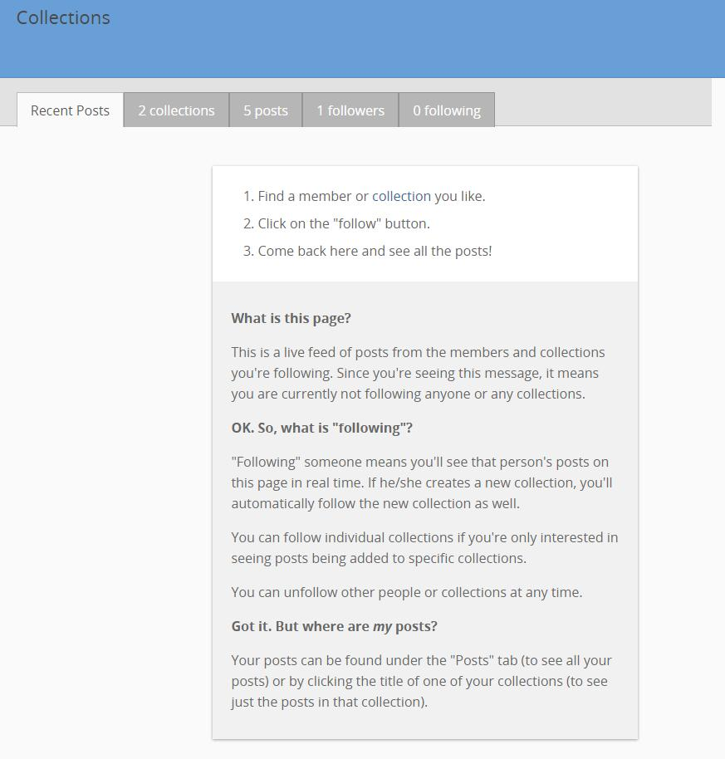
Think
Favorites

Slide 11
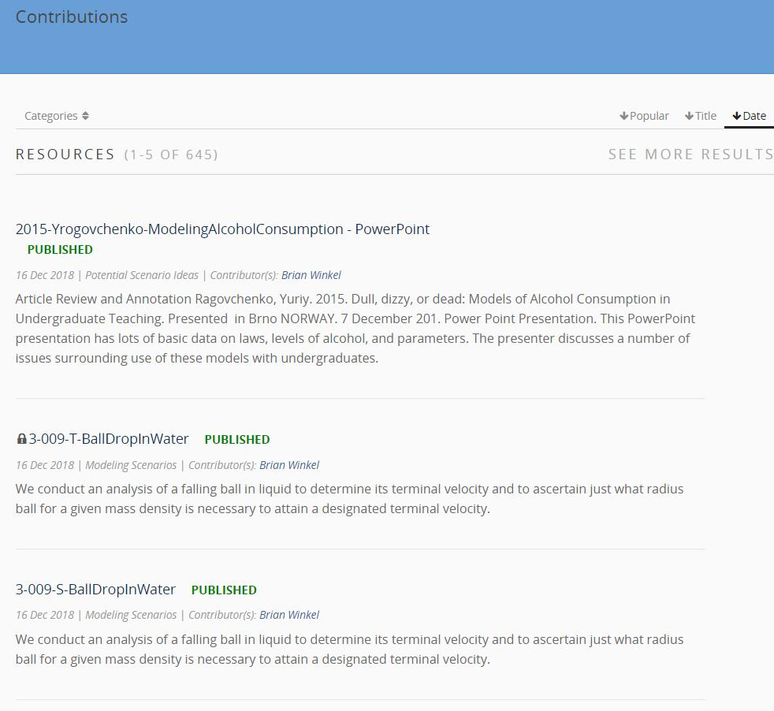

Slide 12
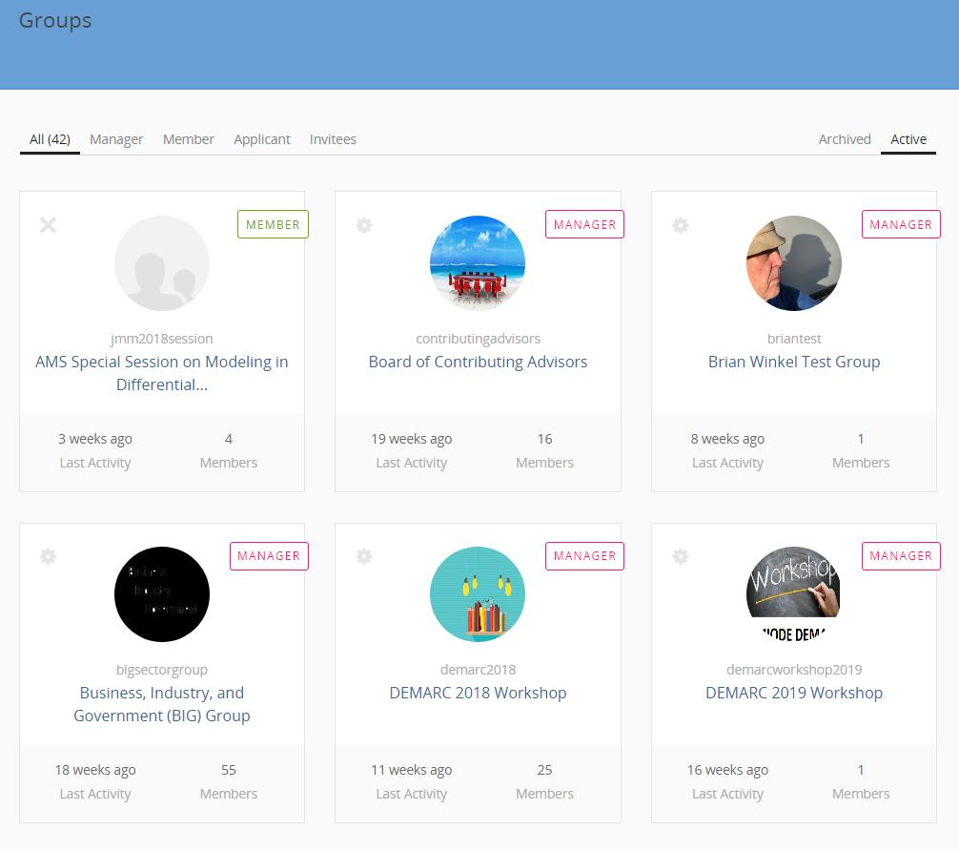

Slide 13
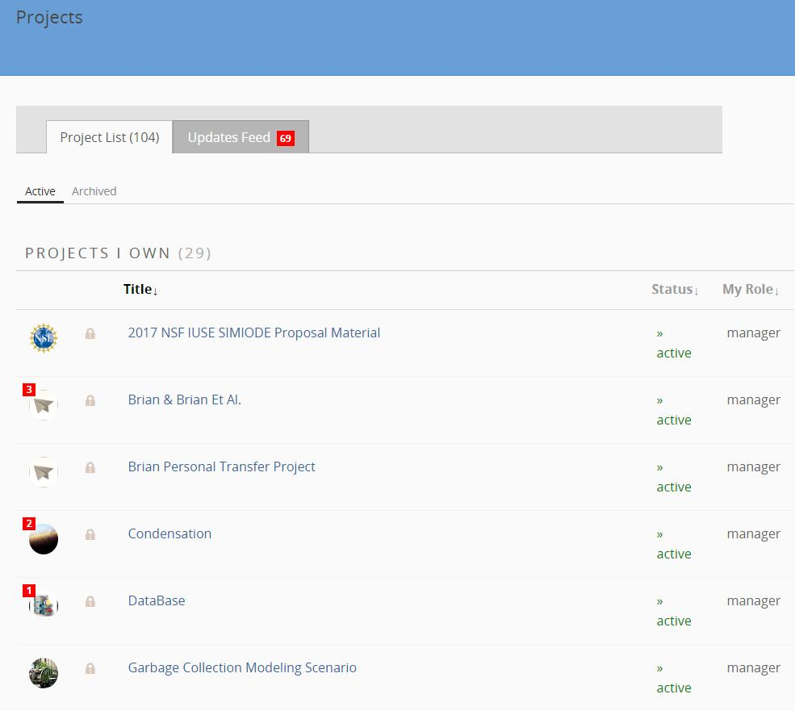

Slide 15
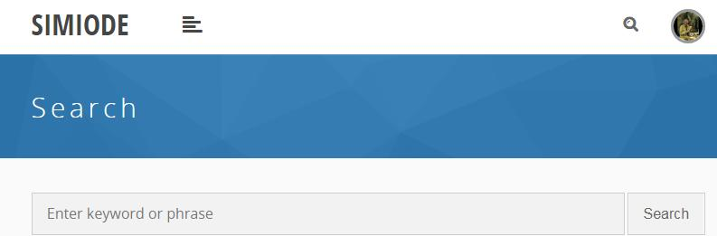
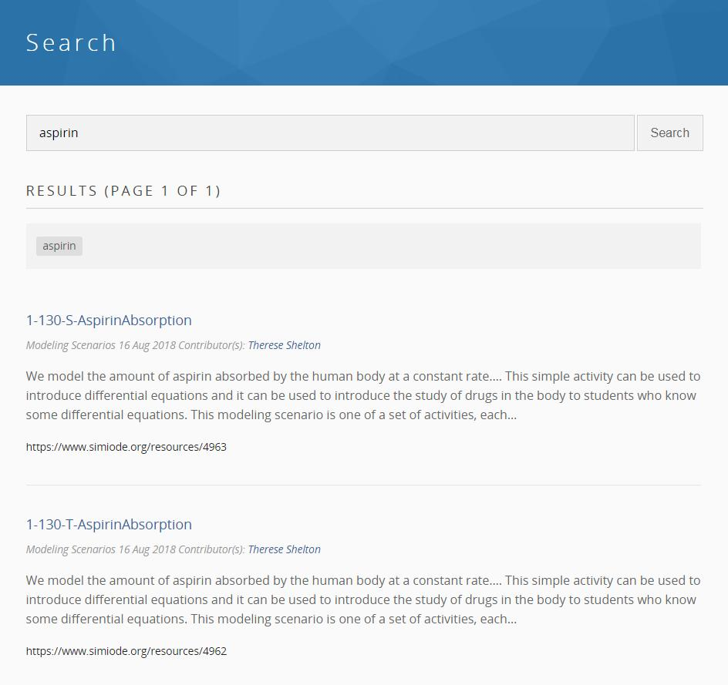

Slide 16
Click here
to go to
set of
Modeling
Scenarios

Slide 17
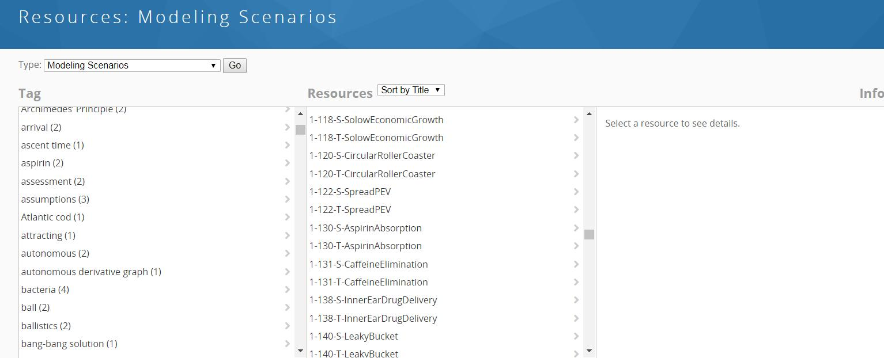
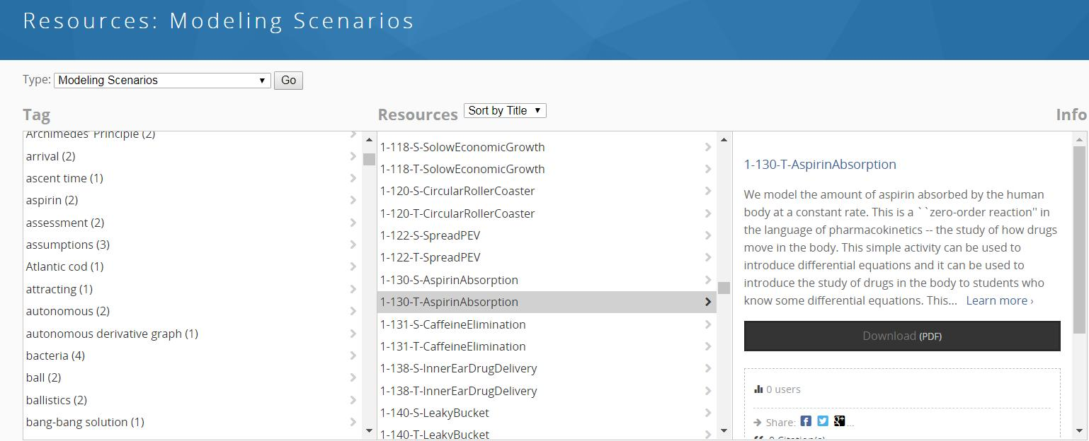

Slide 18
Abstract
Main
file

Slide 19
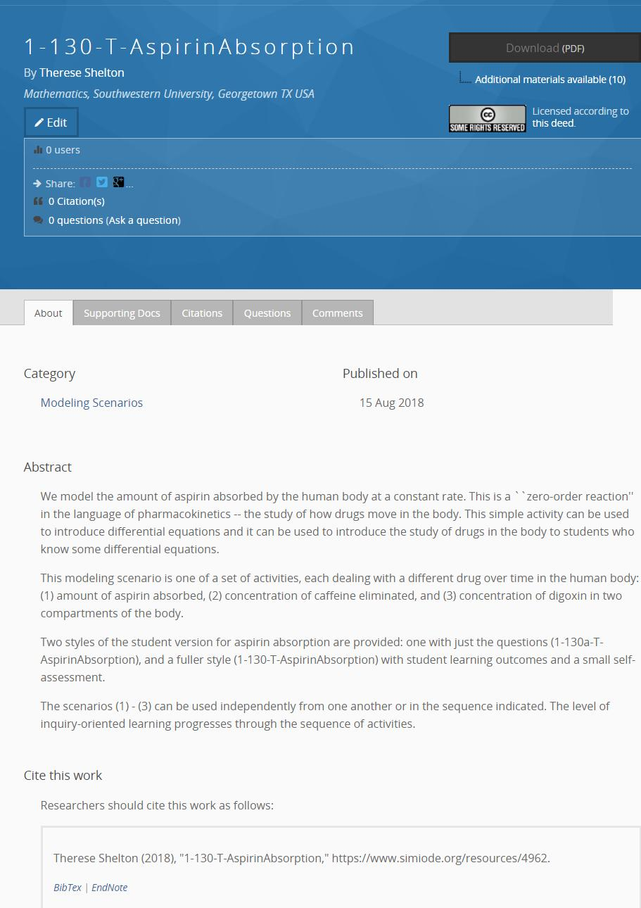
Main file
Modifiable LaTeX file
Images, data, videos,
spreadsheet, programs,
etc.
Abstract
Citation

Slide 20
Main file
Modifiable LaTeX file
Images, data, videos,
spreadsheet, programs,
etc.
Published
under most
generous
Creative
Commons
license.
Valued!
Abstract
Citation

Slide 21
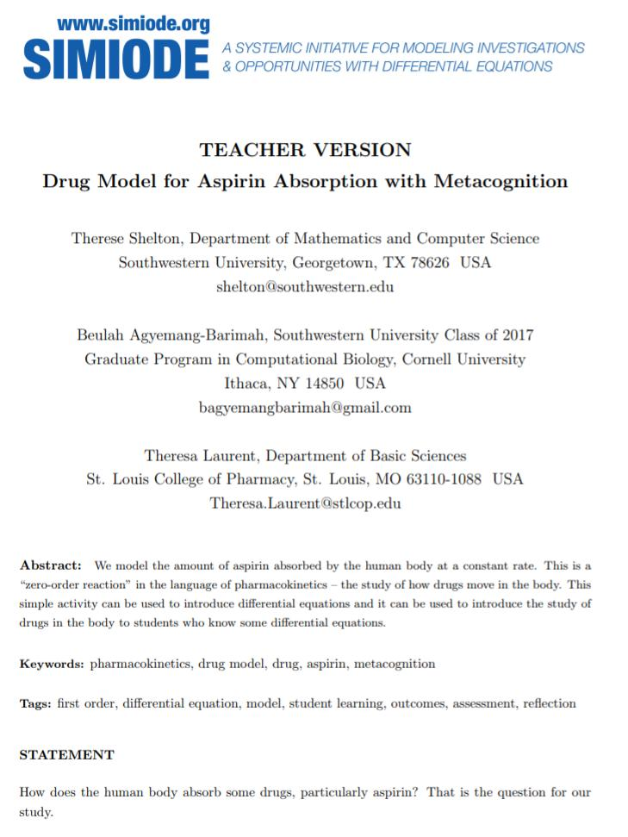
Teacher version
Student version has no abstract,
no keywords, and no tags.
No emails from authors.
Student version would just have
statement and no teacher
Comments.

Slide 22
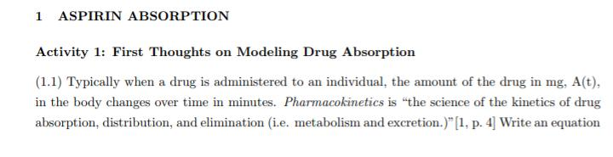
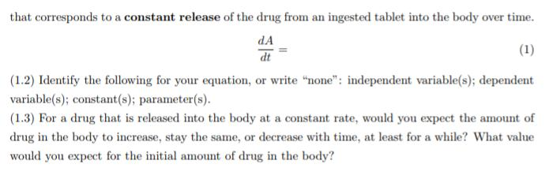

Slide 23
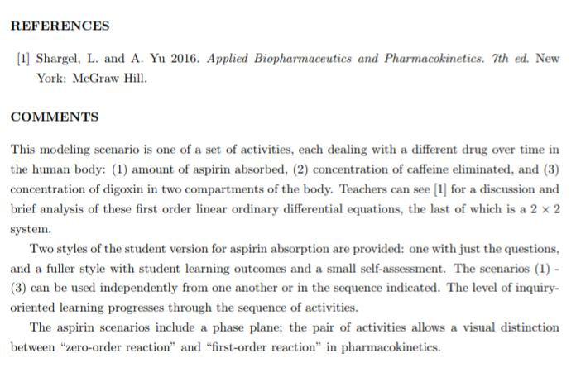
Comments for
teachers both
at end in a
COMMENTS
section or in
text itself, but
only in Teacher
version.

Slide 24
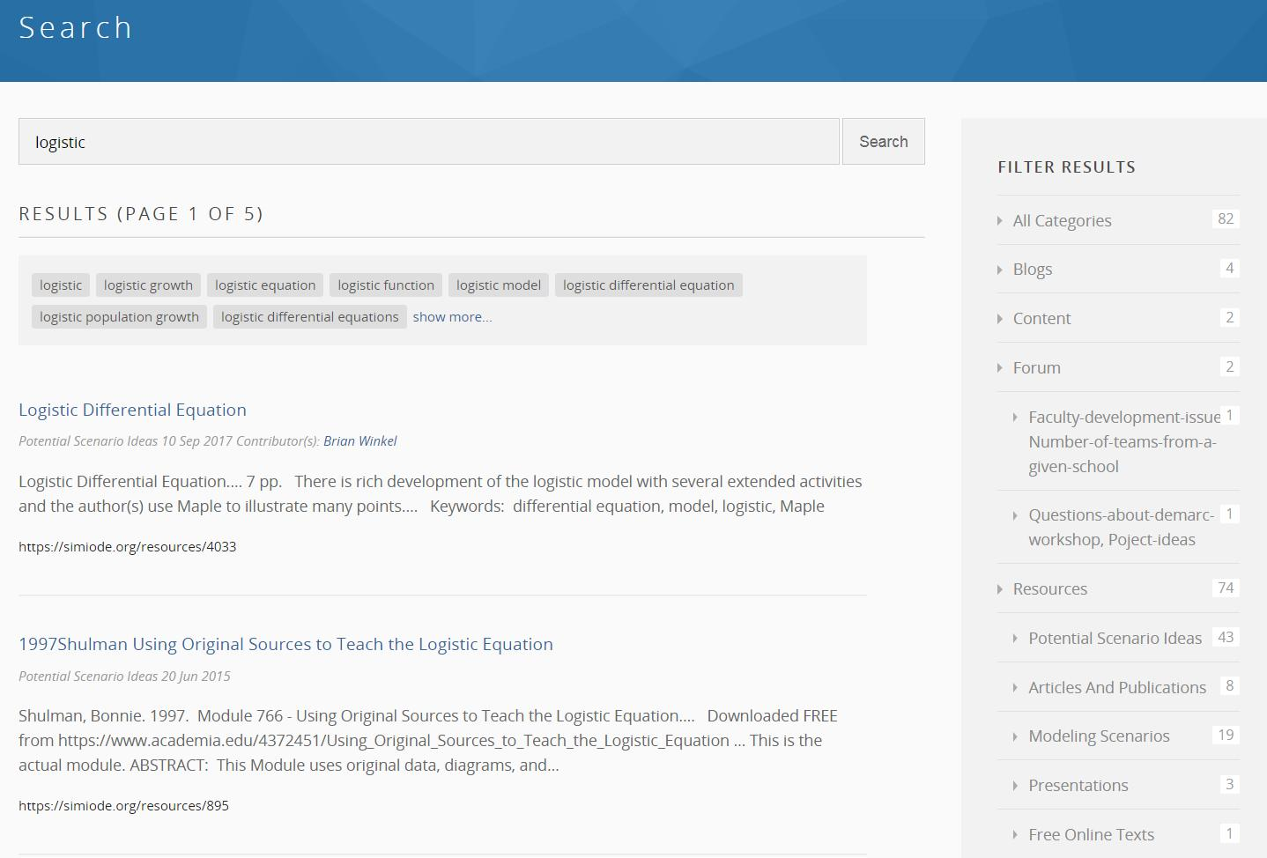
Incidentally . . .
All resources
in which the
word logistic
appears.

Slide 25
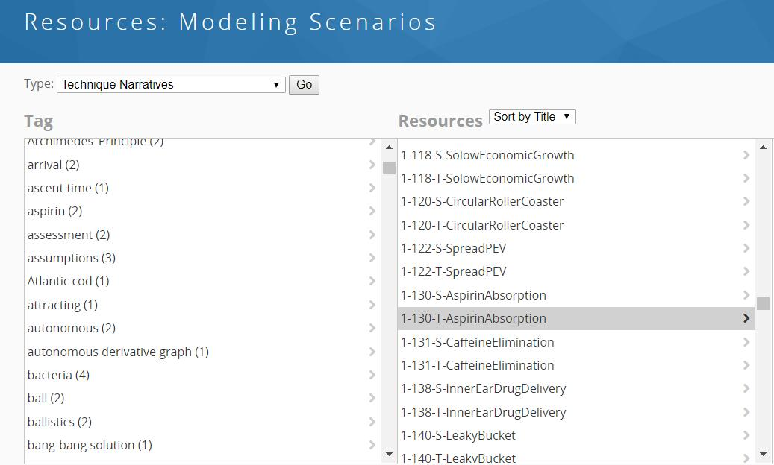
Navigate to other Resources – in this case Technique Narratives

Slide 26
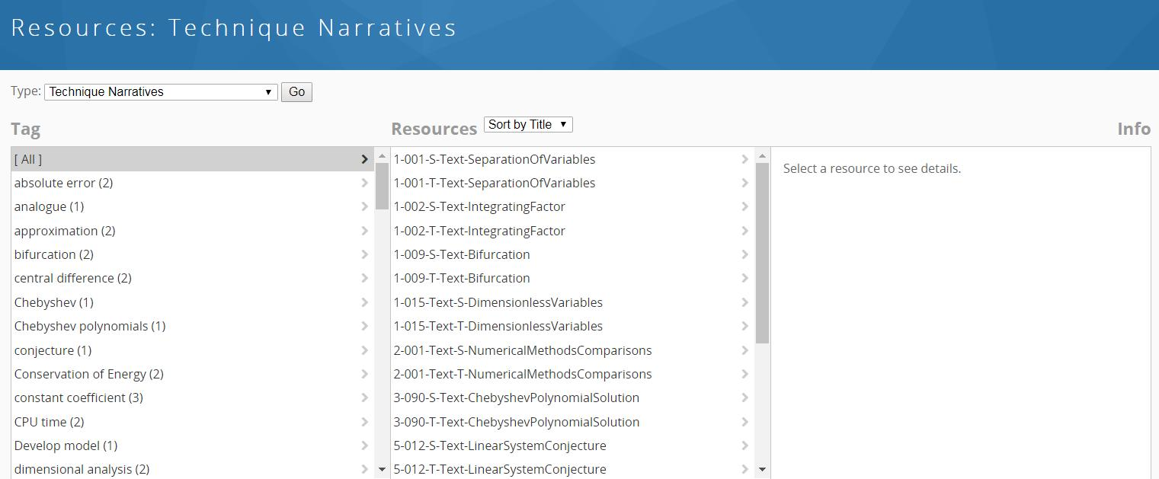
What is this about?

Slide 27
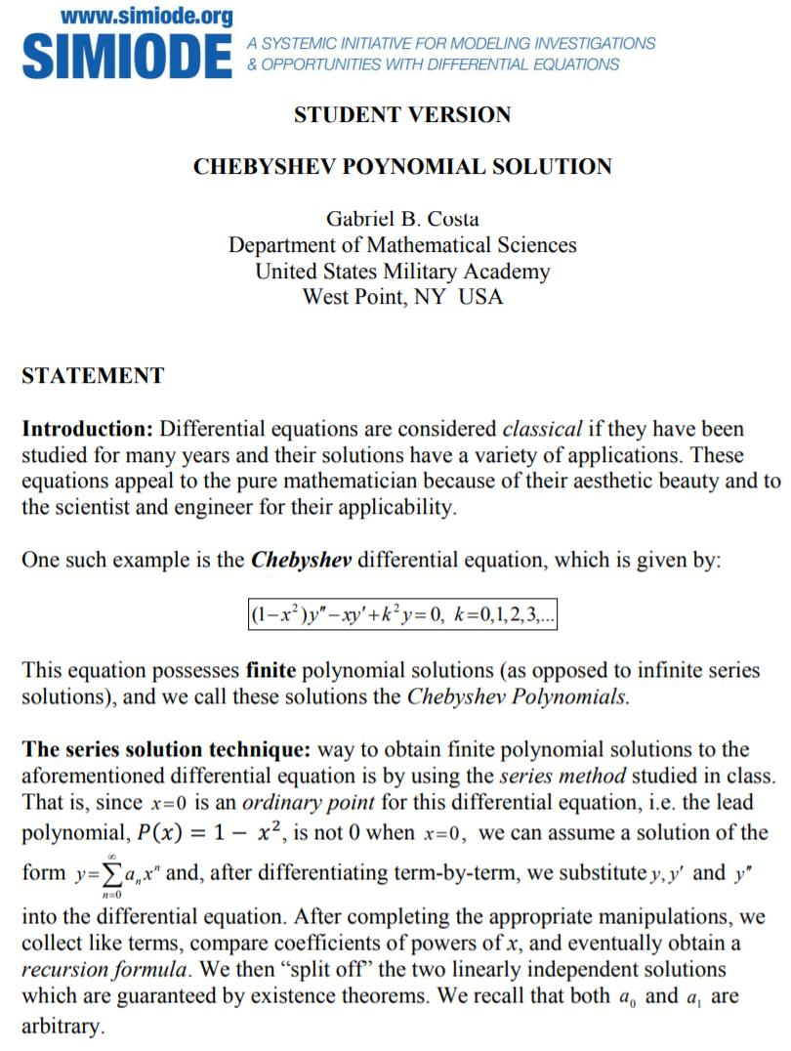

Slide 28
Something
Different!

Slide 29
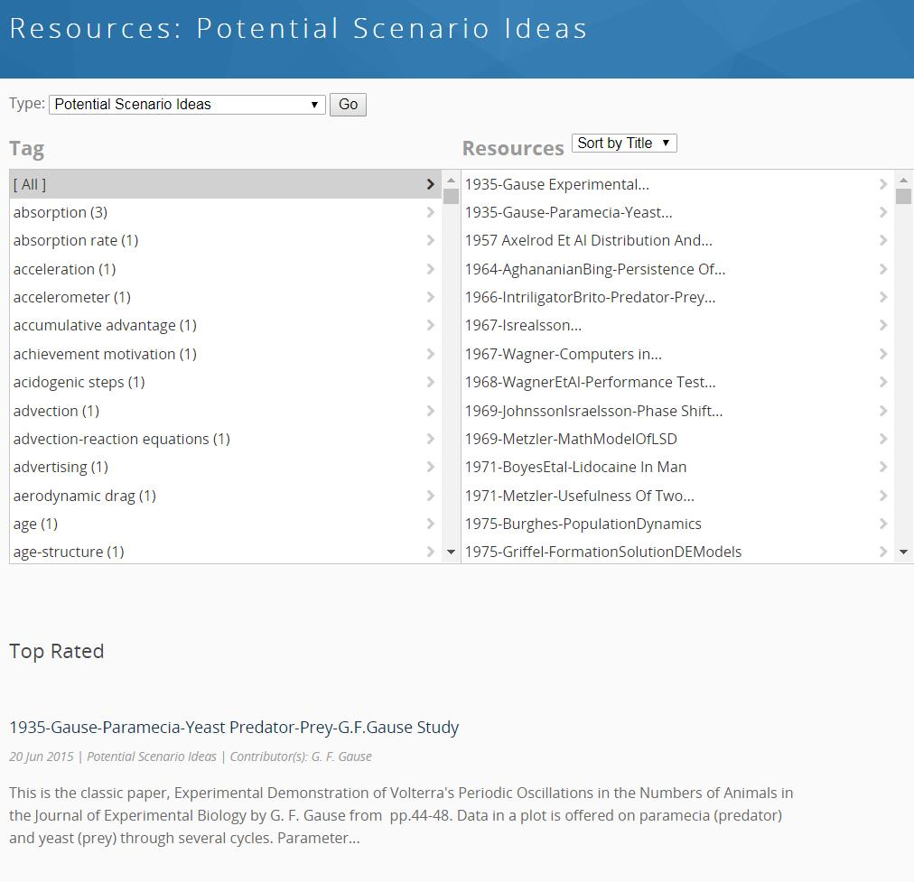
Potential Scenario Ideas
Articles, talks, reviews,
etc. to give you ideas to
develop your own or
your students’ projects.
There are hundreds of
Potential Scenario Ideas

Slide 30
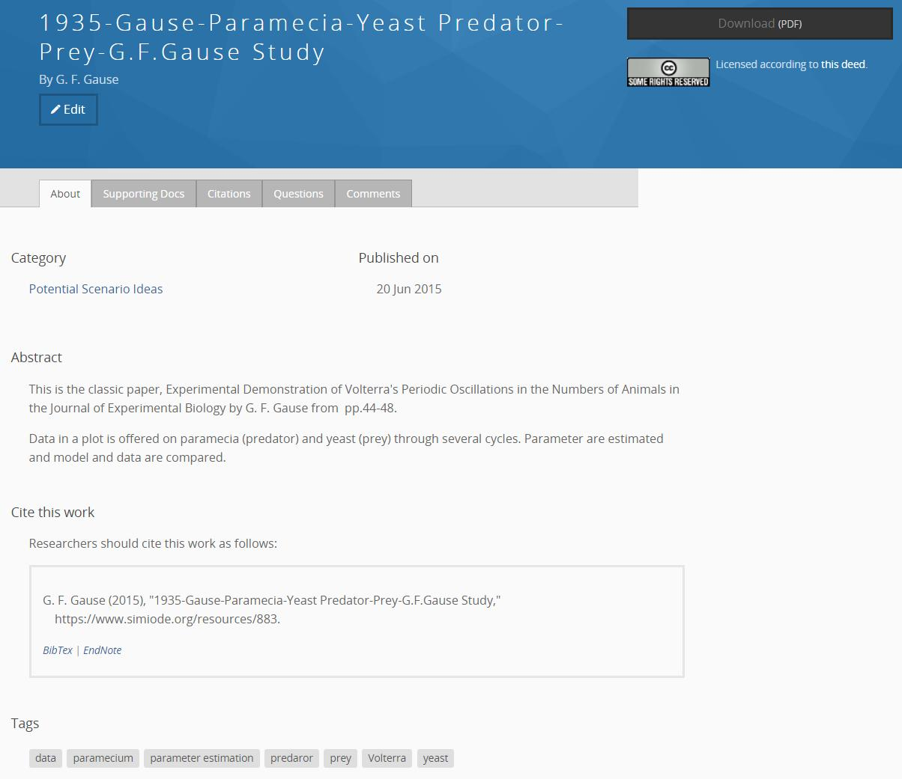
Annotated review
or
Actual material
If not then there
is reference given.

Slide 31
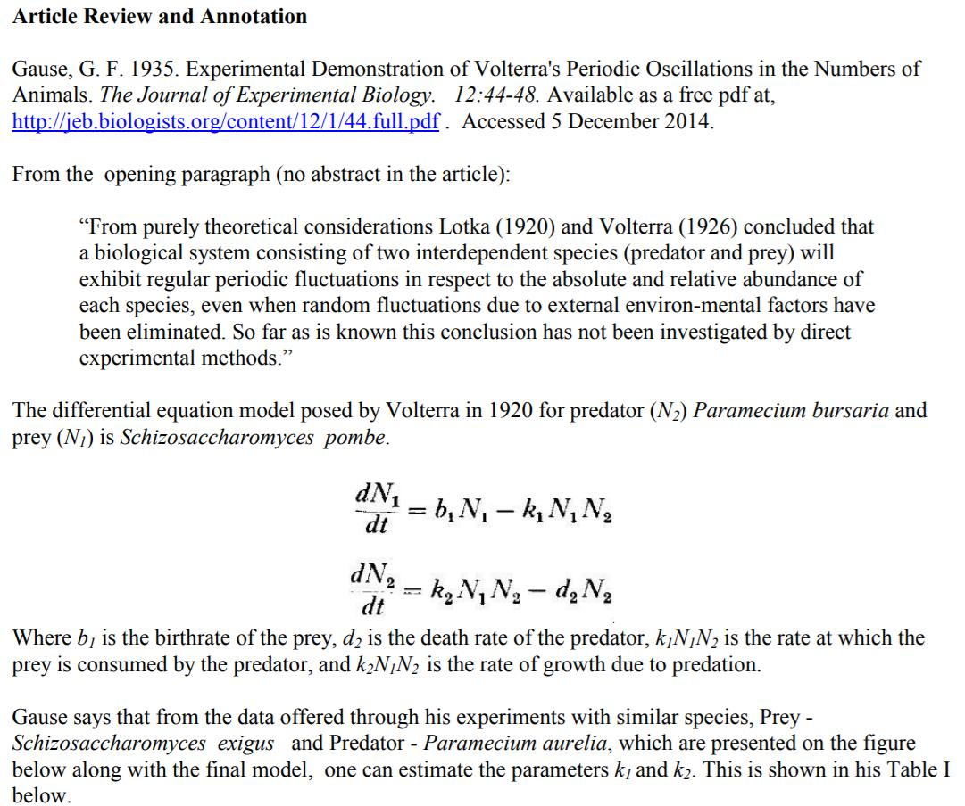

Slide 32
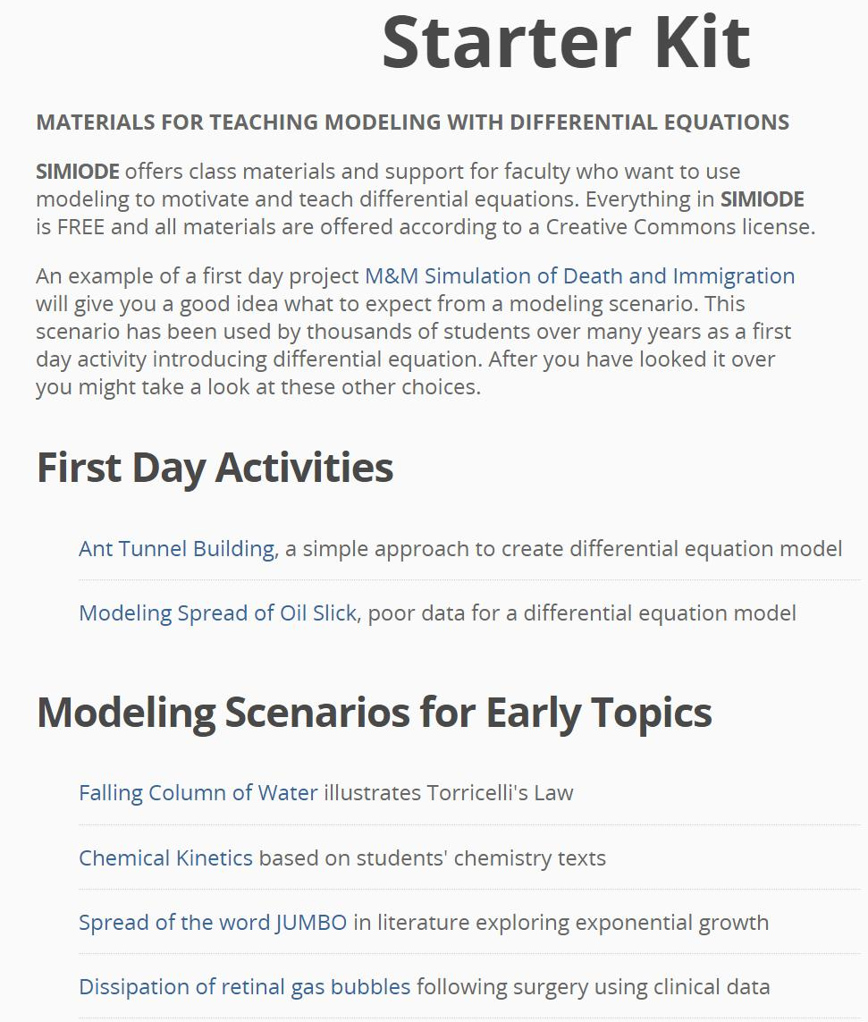

Slide 33
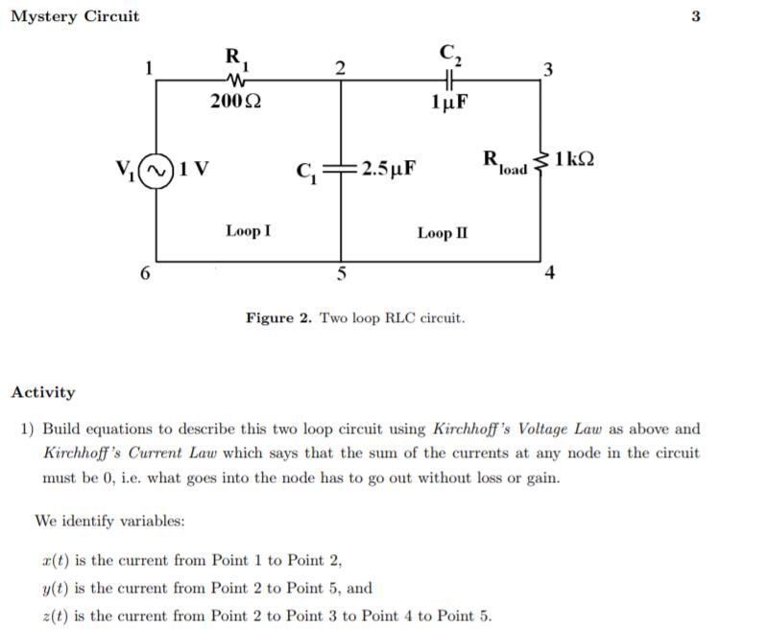
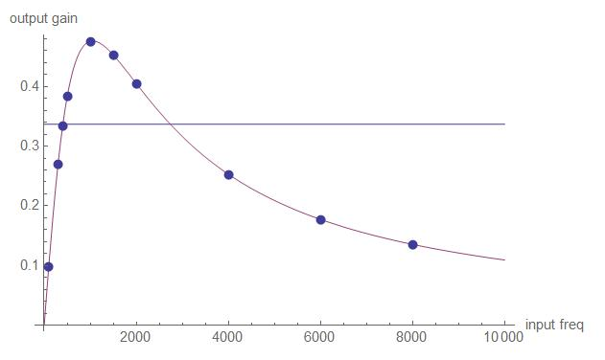
4-023-T-MysteryCircuit-TeacherVersion
Each student given different input
voltage frequency V1(t) and asked for
homework to compute gain, i.e. ratio
of output voltage to input voltage.
Gain plotted and compared to model.

Slide 34
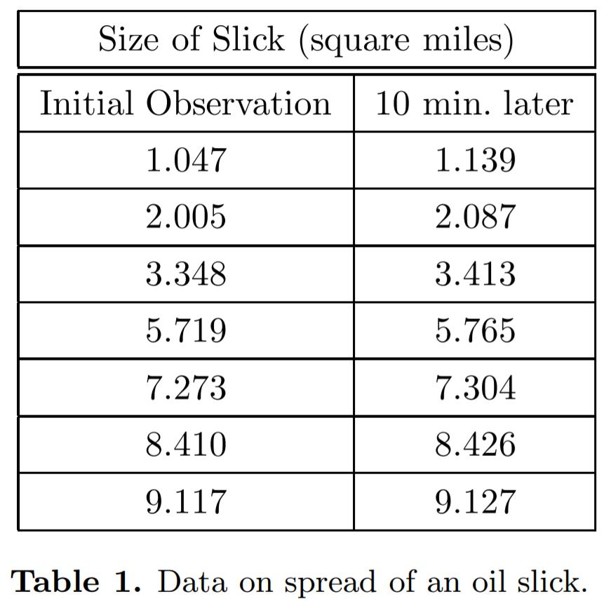
1-005-T-OilSlick
Given data model size
of oil slick.
Frustration as usually
we plot something against
time.

Slide 35
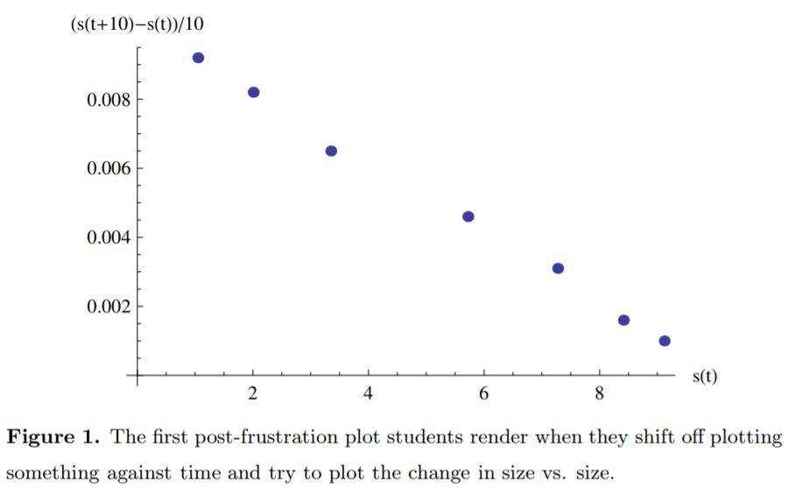
1-005-T-OilSlick
Given data model size
of oil slick.
Frustration as usually we
plot something against time.
Times unknown
S’(t) = - 0.001000087 s(t) + 0.0101644,
S(0) = 1.047

Slide 36
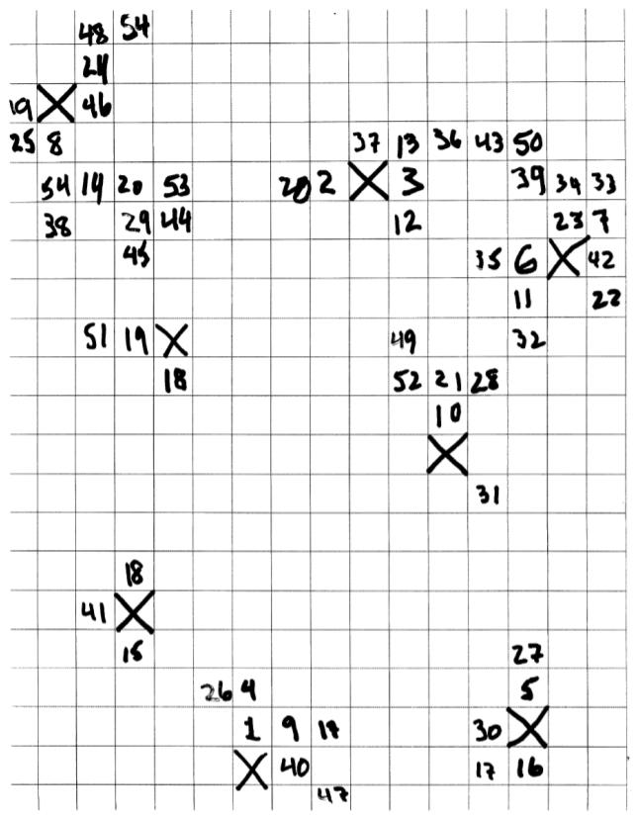
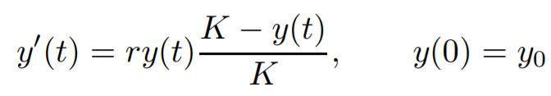
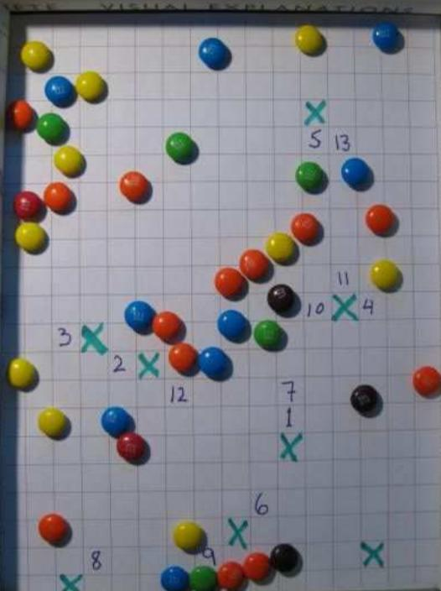
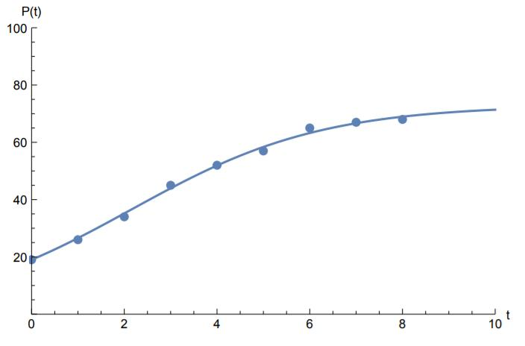
1-017-T-DiseaseSpread
Simulate the spread
of disease with m&m’s.
Build model. . . . logistic
Plot the data, estimate
The parameters, r and K,
and compare with data.
If m&m in susceptible or
tossed population touches
infected “box” then that
m&m becomes infected.

Slide 37
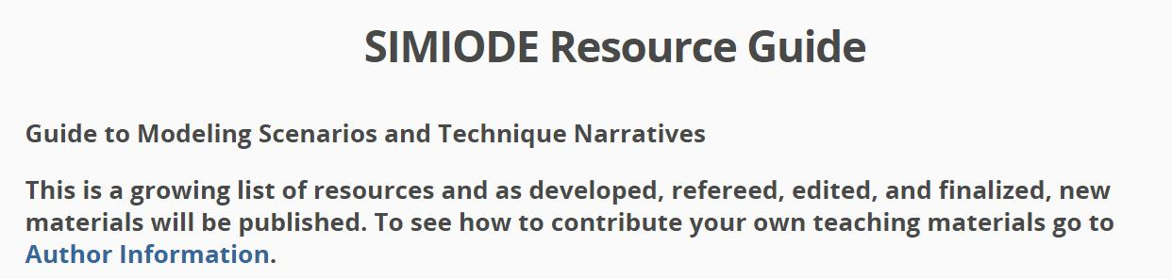
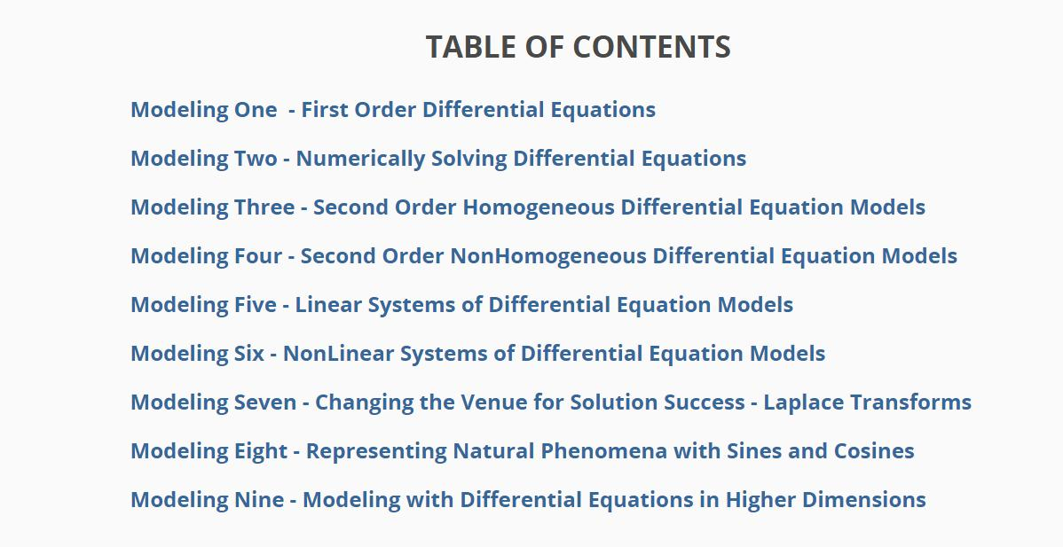

Slide 38
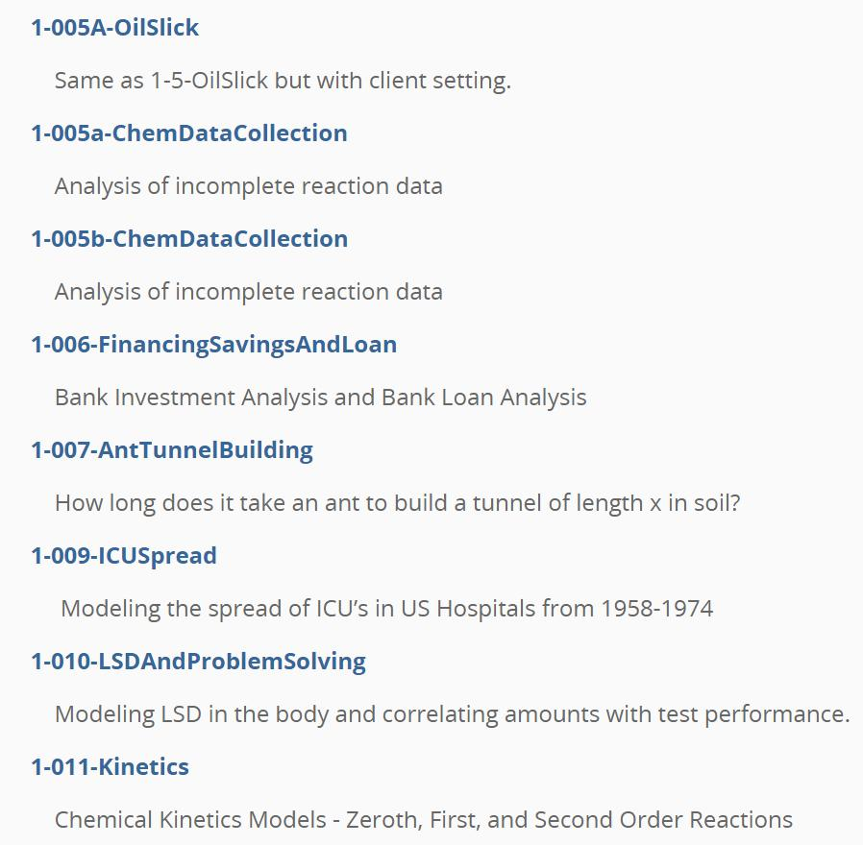

Slide 39
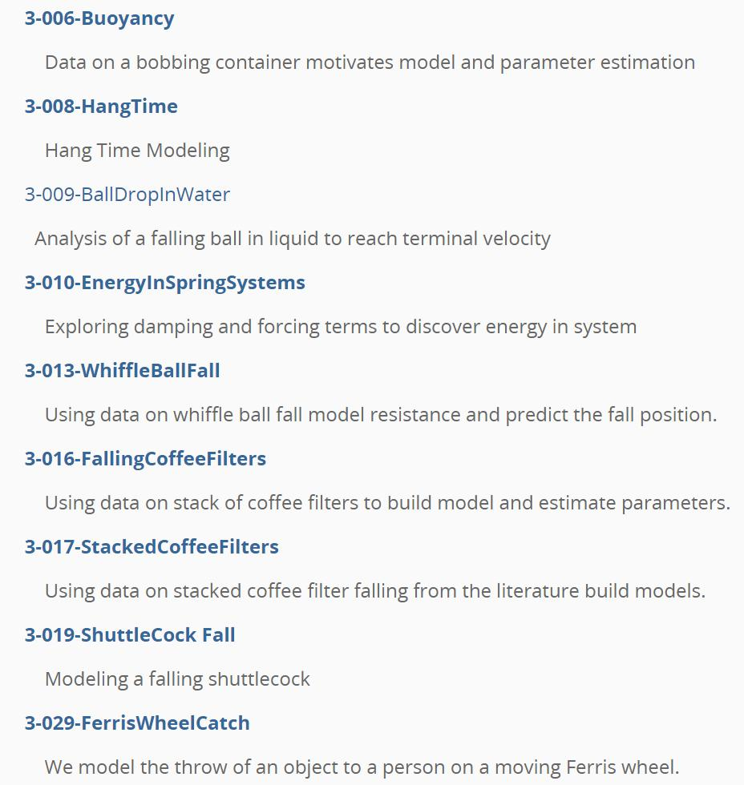

Slide 40
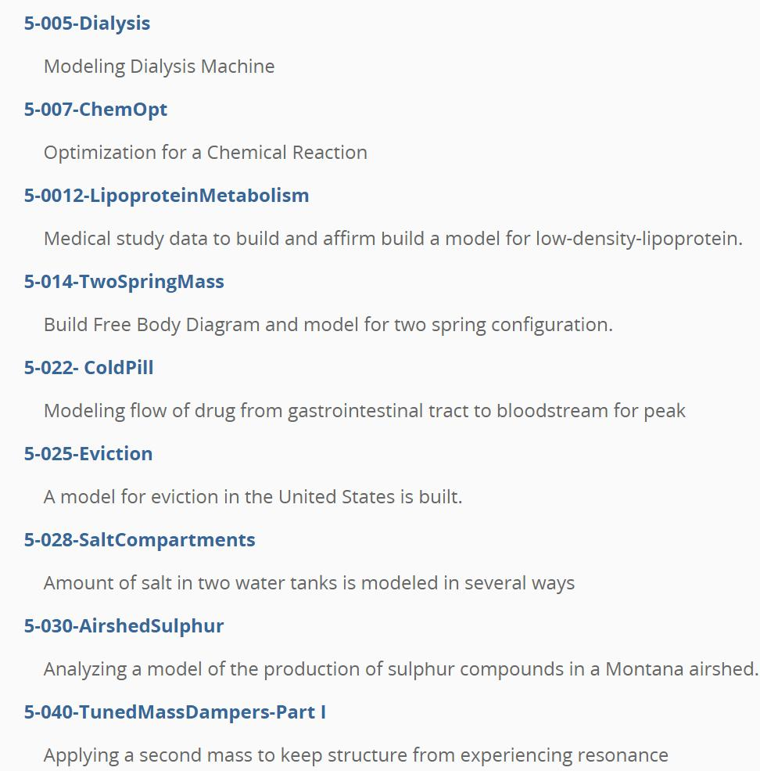
Summer NSF
workshop
participant

Slide 41


Slide 42


Slide 43
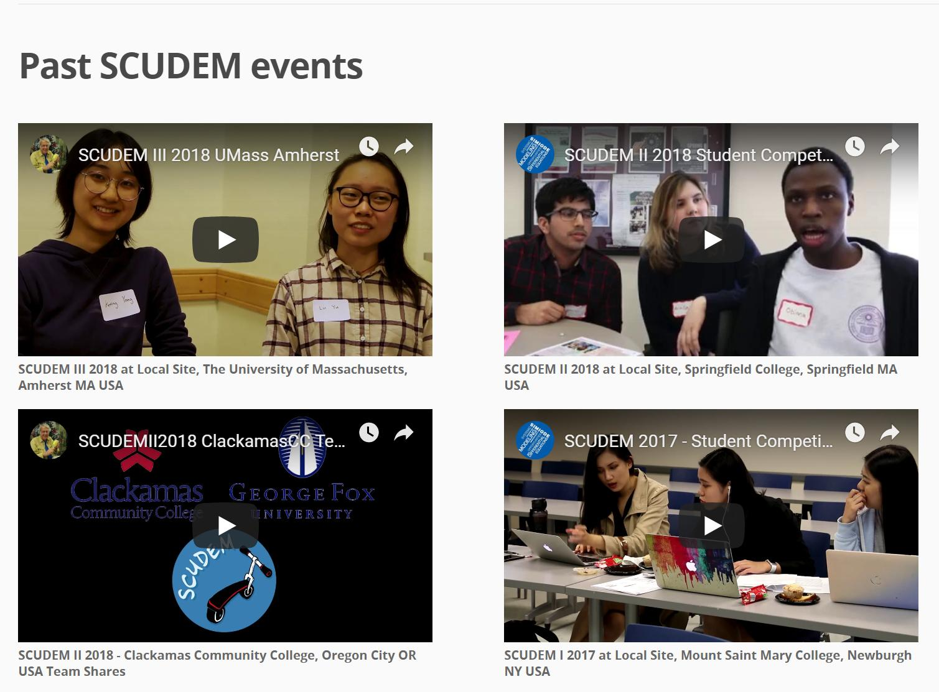
Students share their excitement.

Slide 44
SCUDEM features
Student teams (undergraduate – high school) select one of three problems
(physical science/engineering, chemical/life science, or social science)
Prepare Executive Summary and 10 minute presentation
Work as a team at home institution - come to local site on Challenge Saturday
Incorporate additional information on Challenge Saturday
Faculty coach/mentor two part Faculty Development Workshop
Student fun MathBowl
10 minute Presentations – immediate constructive feedback from faculty
Awards and closing ceremony
SIMIODE prepares ALL MATERIALS.
SIMIODE provides recruit materials and access to 100,000 faculty emails.
Assessment shows SCUDEM increases student self-efficacy for modeling.

Slide 45
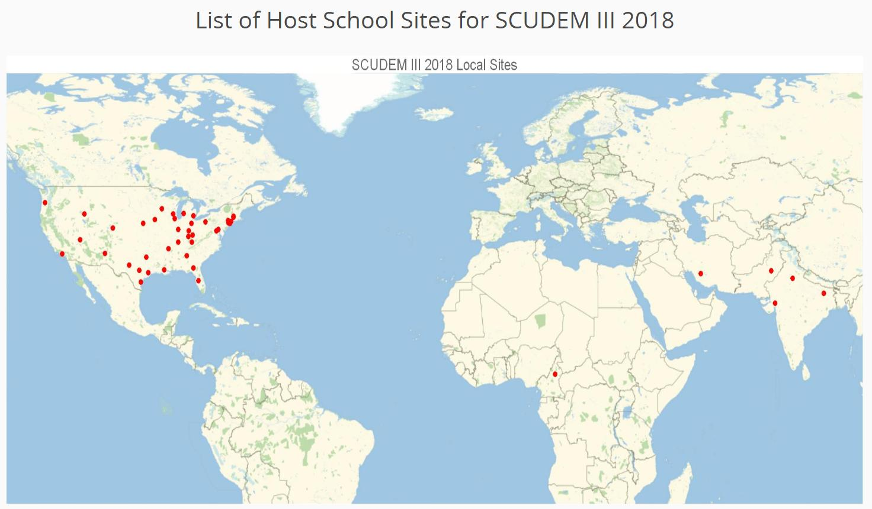

Slide 46

Host coordinators receive half of all the visiting teams’ $100 US Registration Fee.
Visit simiode.org/scudem OR just type scudem in Google
All past problems and team submissions posted.

Slide 47
Thank you for sharing your time with us.

